Slide 1
The Cultural Landscape: An Introduction to Human Geography
Thirteenth Edition
Chapter 4 Lecture
Culture & Social Media
Copyright © 2020 Pearson Education, Inc. All Rights Reserved
Notes:
If this PowerPoint presentation contains mathematical equations, you may need to check that your computer has the following installed:
1) MathType Plugin
2) Math Player (free versions available)
3) NVDA Reader (free versions available)

Slide 2
Culture and Social Media: Key Issues
4.1 Where Are Cultural Groups Distributed?
4.2 Where Are Leisure and Material Culture Distributed?
4.3 Why Is Access to Culture Unequal?
4.4 Why Do Cultures Face Sustainability Challenges?

Slide 3
Key Issue 1: Where Are Cultural Groups Distributed?
4.1.1 Culture, Social Media, and Geography
4.1.2 Elements of Cultural Geography
4.1.3 Diffusion of Electronic Communications

Slide 4
4.1.1 Culture, Social Media and Geography (1 of 2)
A habit is a repetitive act that a particular individual performs
A custom is a repetitive act of a group, performed to the extent that it becomes characteristic of the group
Folk culture is traditionally practiced primarily by small, homogeneous groups living in isolated rural areas
Popular culture is found in large, heterogeneous societies that share certain habits despite other differences

Slide 5
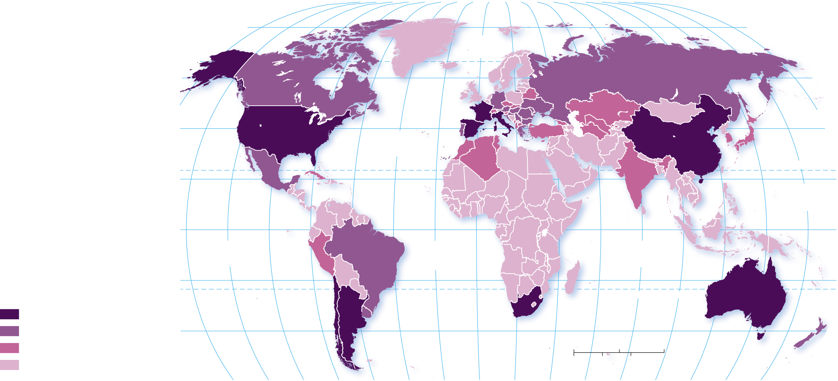
4.1.1 Culture, Social Media and Geography (2 of 2)
Figure 4-1: The distribution of wine production is influenced in part by the physical environment and in part by social customs.
80°
160°
140°
120°
100°
80°
60°
40°
20°
0°
20°
40°
60°
80°
100°
120°
140°
160°
180°
80°
ARCTIC
OCEAN
60°
60°
160°
180°
40°
ATLANTIC
OCEAN
40°
20°
TROPIC OF CANCER
20°
PACIFIC
OCEAN
0°
EQUATOR
0°
PACIFIC
OCEAN
ATLANTIC
OCEAN
INDIAN
OCEAN
20°
20°
Wine production (metric tons)
TROPIC OF CAPRICORN
1 million and above
100,000–999,000
40°
40°
10,000–99,999
0
1,500
3,000 Miles
below 10,000
0
1,500
3,000 Kilometers
160°
140°
120°
100°
80°
60°
40°
20°
0°
20°
40°
60°
80°
100°
120°
140°
160°
180°

Slide 6
4.1.2 Elements of Cultural Geography (1 of 3)
Folk culture
Origin: anonymous, sometimes multiple hearths
Diffusion: slowly, through migration diffusion
Distribution: spatially isolated, influenced by local factors
Popular culture
Origin: specific point of origin, usually developed country
Diffusion: rapidly through hierarchical diffusion
Distribution: widespread wherever technology allows

Slide 7
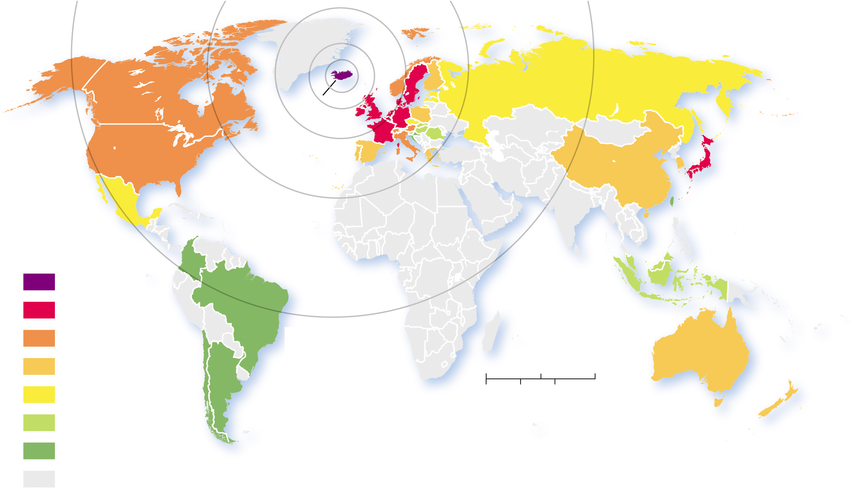
4.1.2 Elements of Cultural Geography (2 of 3)
Figure 4-6: Sigur Rós concert tours originated in Iceland and diffused to Europe, then to the rest of the world.
ARCTIC
OCEAN
ICELAND
PACIFIC
OCEAN
ATLANTIC
OCEAN
PACIFIC
OCEAN
Sigur Rós
concert tours
1999
INDIAN
OCEAN
2000
2002
2003–2006
0
1,500
3,000 Miles
2008
0
1,500
3,000 Kilometers
2012–2016
2017–2018
never toured

Slide 8
4.1.2 Elements of Cultural Geography (3 of 3)
Figure 4-7: Distribution of different folk cultural painting traditions from four different parts of the Himalaya Mountains.
BUDDHIST
FOLK RELIGIONIST
MUSLIM
0
150
300 Miles
Buddhist
0
150
300 Kilometers
Muslim
PAKISTAN
CHINA
(Tibet)
Folk religionist
Hindu
INDIA
N
Intermediate zone
between Buddhist and Hindu
NEPAL
BHUTAN
HINDU

Slide 9
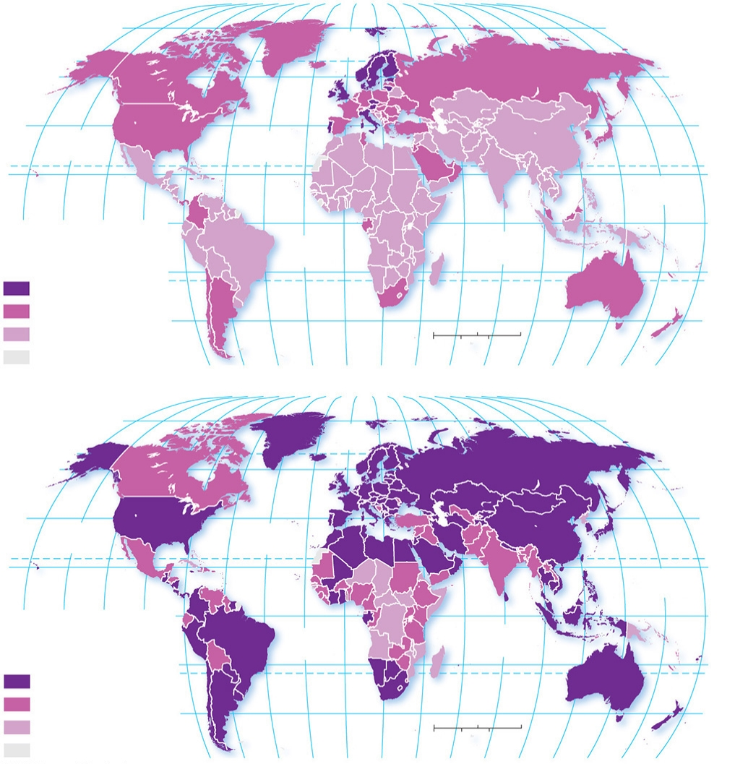
4.1.3 Diffusion of Electronic Communications (1 of 5)
Figure 4-8: In 2005, most cell phones (a) were in Europe and North America. By 2017, cell phone ownership (b) was common in much of the world.
80°
160°
140°
120°
100°
80°
60°
40°
20°
0°
20°
40°
60°
80°
100°
120°
140°
160°
180°
80°
(a) 2005
ARCTIC
OCEAN
60°
60°
40°
PACIFIC
OCEAN
ATLANTIC
OCEAN
40°
20°
TROPIC OF CANCER
20°
PACIFIC
OCEAN
160°
140°
120°
100°
0°
EQUATOR
0°
Cell phones per
1,000 persons, 2005
20°
ATLANTIC
OCEAN
INDIAN
OCEAN
20°
1,000 and above
TROPIC OF CAPRICORN
500–999
40°
0
1,500
3,000 Miles
40°
below 500
0
1,500
3,000 Kilometers
no data
80°
60°
40°
20°
0°
20°
40°
60°
80°
100°
120°
140°
160°
180°
80°
160°
140°
120°
100°
80°
60°
40°
20°
0°
20°
40°
60°
80°
100°
120°
140°
160°
180°
80°
(b) 2017
ARCTIC
OCEAN
60°
60°
40°
PACIFIC
OCEAN
ATLANTIC
OCEAN
40°
20°
TROPIC OF CANCER
20°
PACIFIC
OCEAN
160°
140°
120°
100°
0°
ATLANTIC
OCEAN
INDIAN
OCEAN
EQUATOR
0°
Cell phones per
1,000 persons, 2017
20°
20°
1,000 and above
TROPIC OF CAPRICORN
500–999
40°
0
1,500
3,000 Miles
40°
below 500
0
1,500
3,000 Kilometers
no data
80°
60°
40°
20°
0°
20°
40°
60°
80°
100°
120°
140°
160°
180°

Slide 10
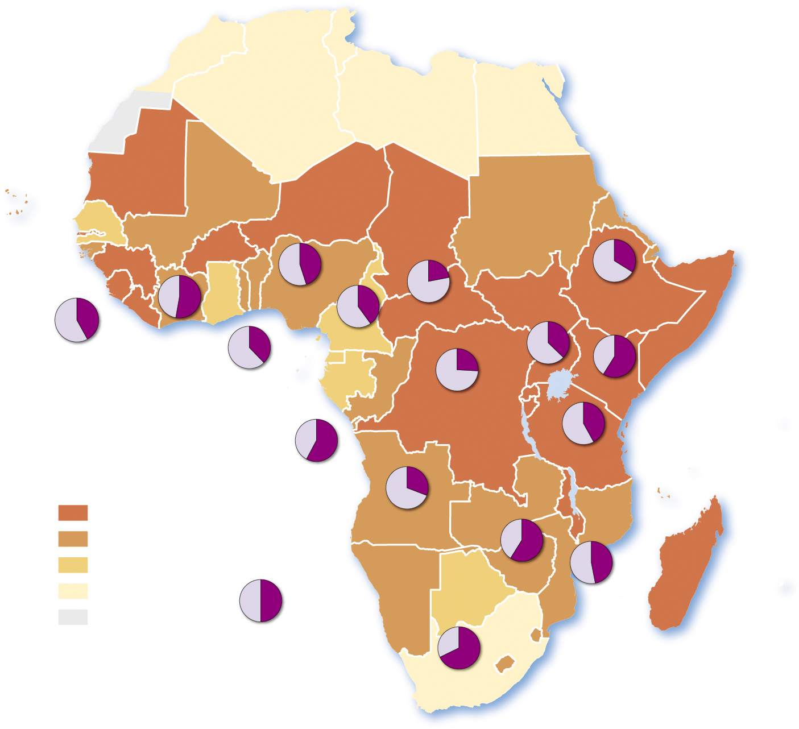
4.1.3 Diffusion of Electronic Communications (2 of 5)
Figure 4-9: The percent of people in Sub-Saharan Africa with mobile phones is linked to the percent of people with access to electricity.
45
22
34
42
53
NIGERIA
40
CENT. AFR. REP.
ETHIOPIA
SIERRA LEONE
CÔTE
D’IVOIRE
38
CAMEROON
26
41
59
TOGO
UGANDA
KENYA
DEM. REP. OF
THE CONGO
42
Percent lacking
electricity
58
TANZANIA
CONGO
31
75 and above
ANGOLA
50–74
Percent with
mobile phones
58
47
25–49
ZIMBABWE
below 25
50
MOZAMBIQUE
no data
68
SOUTH
AFRICA

Slide 11
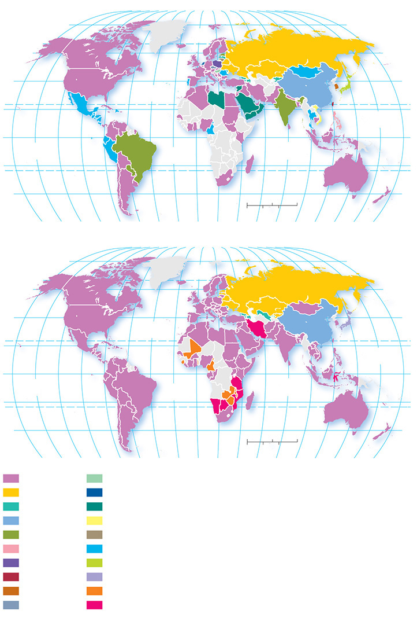
4.1.3 Diffusion of Electronic Communications (3 of 5)
Figure 4-10: Most popular social network, 2009. A wide variety of social media were in use globally, especially in Eastern Europe and Southeast Asia. By 2018, Facebook had come to dominate except in countries where the government limited access.
(a) 2009
80°
160°
140°
120°
100°
80°
60°
40°
20°
0°
20°
40°
60°
80°
100°
120°
140°
160°
180°
80°
60°
ARCTIC
OCEAN
60°
40°
ATLANTIC
OCEAN
TROPIC OF CANCER
40°
20°
PACIFIC
OCEAN
20°
0°
PACIFIC
OCEAN
ATLANTIC
OCEAN
INDIAN
OCEAN
EQUATOR
0°
20°
TROPIC OF CAPRICORN
20°
40°
0
1,500
3,000 Miles
40°
160°
140°
120°
100°
80°
60°
40°
20°
0°
20°
40°
0
1,500
3,000 Kilometers
(b) 2018
60°
80°
100°
120°
140°
160°
180°
80°
160°
140°
120°
100°
80°
60°
40°
20°
0°
20°
40°
60°
80°
100°
120°
140°
160°
180°
80°
60°
ARCTIC
OCEAN
60°
40°
ATLANTIC
OCEAN
TROPIC OF CANCER
40°
20°
PACIFIC
OCEAN
20°
0°
PACIFIC
OCEAN
ATLANTIC
OCEAN
INDIAN
OCEAN
EQUATOR
0°
20°
TROPIC OF CAPRICORN
20°
40°
0
1,500
3,000 Miles
40°
160°
140°
120°
100°
80°
60°
40°
20°
0°
20°
40°
0
1,500
3,000 Kilometers
Facebook
Iwiw
60°
80°
100°
120°
140°
160°
180°
V Kontakte
Hyves
Odnoklassniki
Maktoob
QZone
Zing
Orkut
One
Friendster
Hi5
Nasza-Klasa
Mixi
Wretch
Twitter
Cyworld
LinkedIn
Lide
Instagram

Slide 12
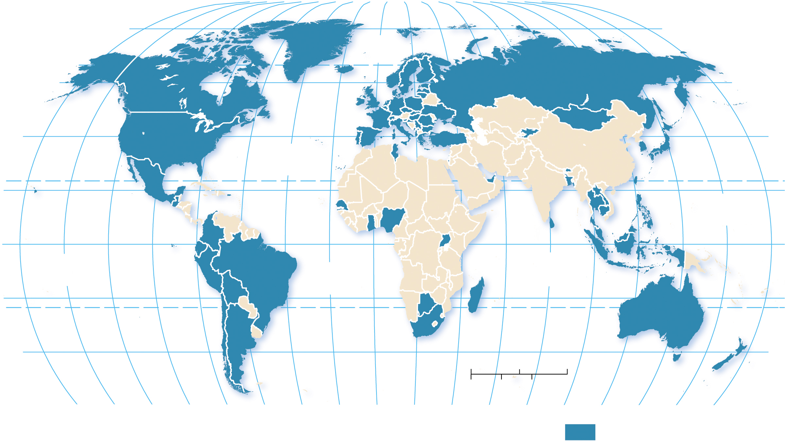
4.1.3 Diffusion of Electronic Communications (4 of 5)
Figure 4-11: The vast majority of the developed world is available in Google Street View.
80°
160°
140°
120°
100°
80°
60°
40°
20°
0°
20°
40°
60°
80°
100°
120°
140°
160°
180°
80°
ARCTIC
OCEAN
60°
60°
40°
40°
ATLANTIC
OCEAN
TROPIC OF CANCER
20°
PACIFIC
OCEAN
20°
0°
EQUATOR
0°
PACIFIC
OCEAN
ATLANTIC
OCEAN
INDIAN
OCEAN
20°
20°
TROPIC OF CAPRICORN
40°
0
1,500
3,000 Miles
40°
0
1,500
3,000 Kilometers
160°
140°
120°
100°
80°
60°
40°
20°
0°
20°
40°
60°
80°
100°
120°
140°
160°
180°
Full or partial
Google Street View

Slide 13
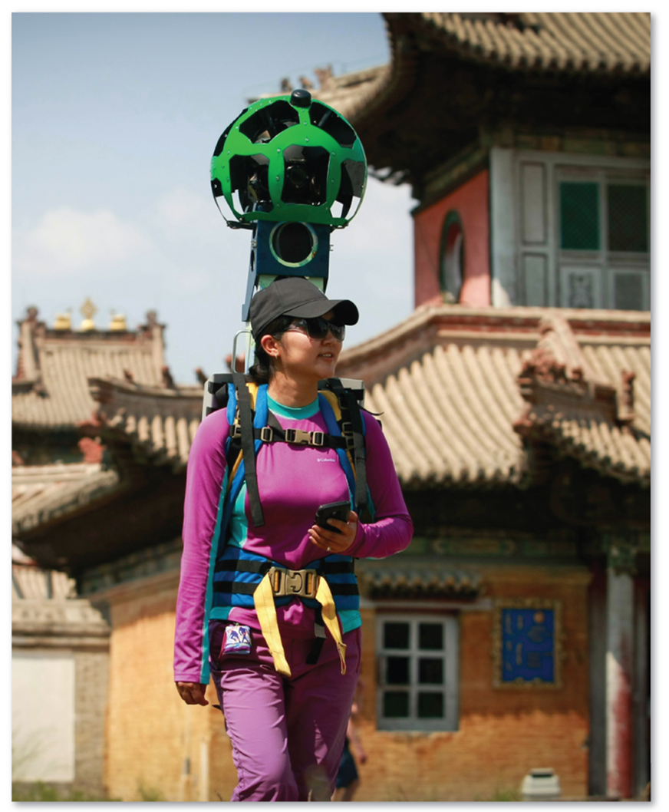
4.1.3 Diffusion of Electronic Communications (5 of 5)
Figure 4-12: A women with a camera recording the surroundings of the Choijin Lama Museum in the Mongolian capital of Ulan Bator.

Slide 14
Key Issue 2: Where Are Leisure and Material Culture Distributed?
4.2.1 Origin and Diffusion of Folk and Popular Music
4.2.2 Origin and Diffusion of Folk and Popular Sports
4.2.3 Distribution of Folk and Popular Clothing
4.2.4 Food Customs
4.2.5 Folk and Popular Housing

Slide 15
4.2.1 Origin and Diffusion of Folk and Popular Music (1 of 5)
Folk music is often anonymous origin and tells a traditional story
Popular music is from known authors and is produced for sale

Slide 16
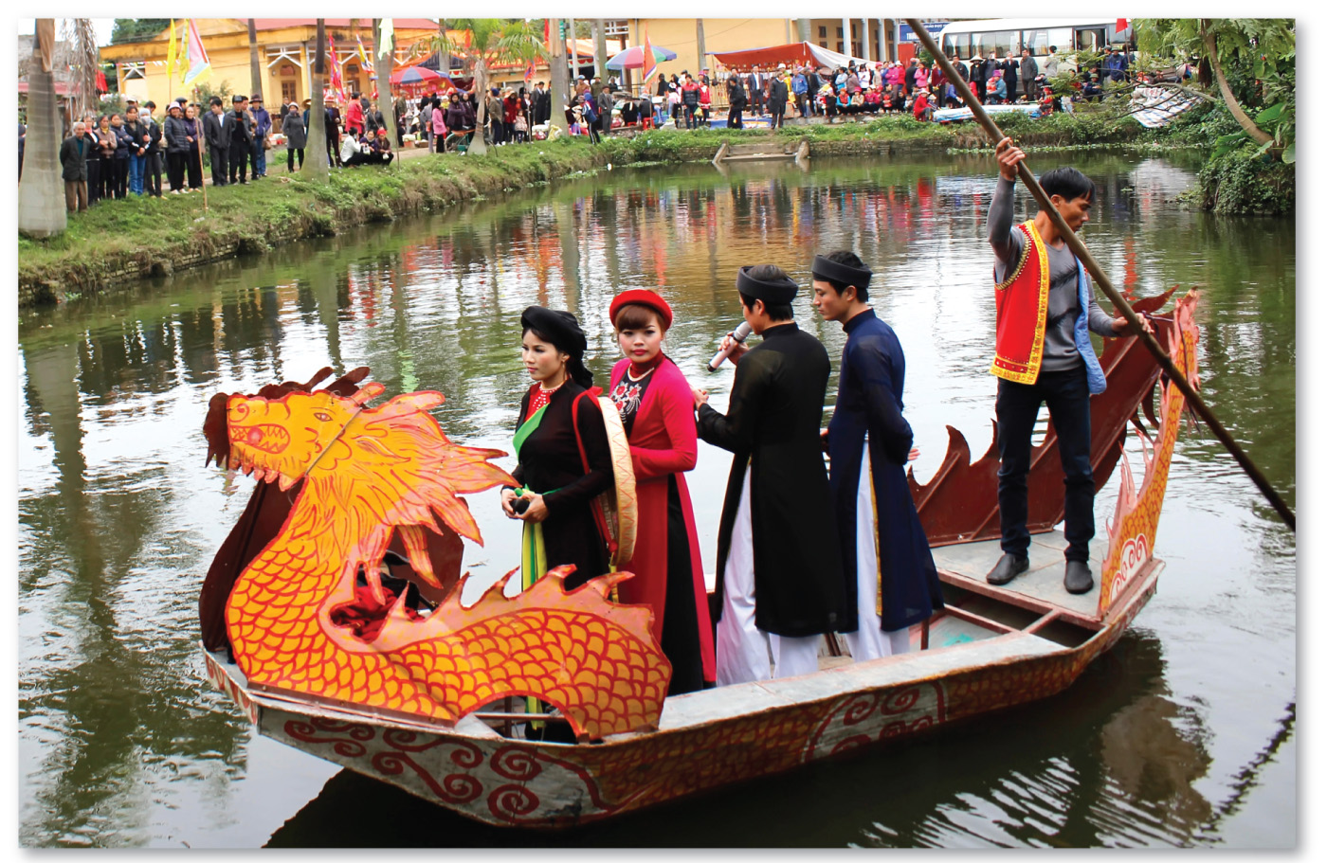
4.2.1 Origin and Diffusion of Folk and Popular Music (2 of 5)
Figure 4-13: Vietnamese singers perform Quan Ho songs with a 500-year tradition.

Slide 17
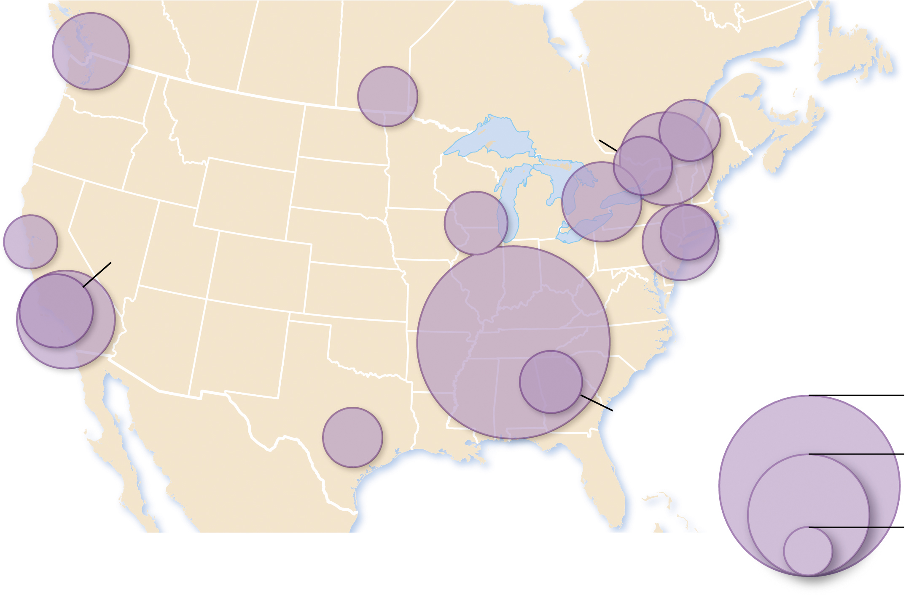
4.2.1 Origin and Diffusion of Folk and Popular Music (3 of 5)
Figure 4-14: Musicians and studios cluster in cities for access to music services and employment. Nashville has by far the largest concentration of musicians per population.
Vancouver
Winnipeg
Québec City
Montréal
Ottawa
Toronto
San Francisco
Bridgeport
Madison
Oxnard
New York
Nashville
Los Angeles
Austin
10
Atlanta
5
1
Location quotient

Slide 18
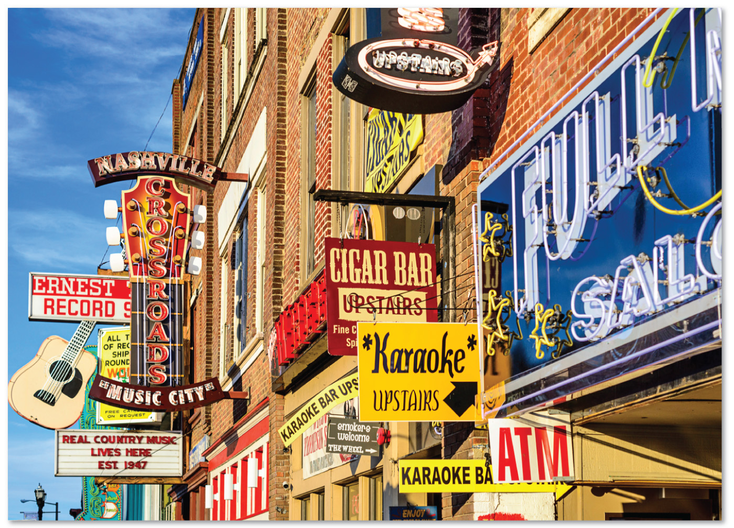
4.2.1 Origin and Diffusion of Folk and Popular Music (4 of 5)
Figure 4-15: Nashville has by far the highest concentration of popular musicians and recording studios.

Slide 19
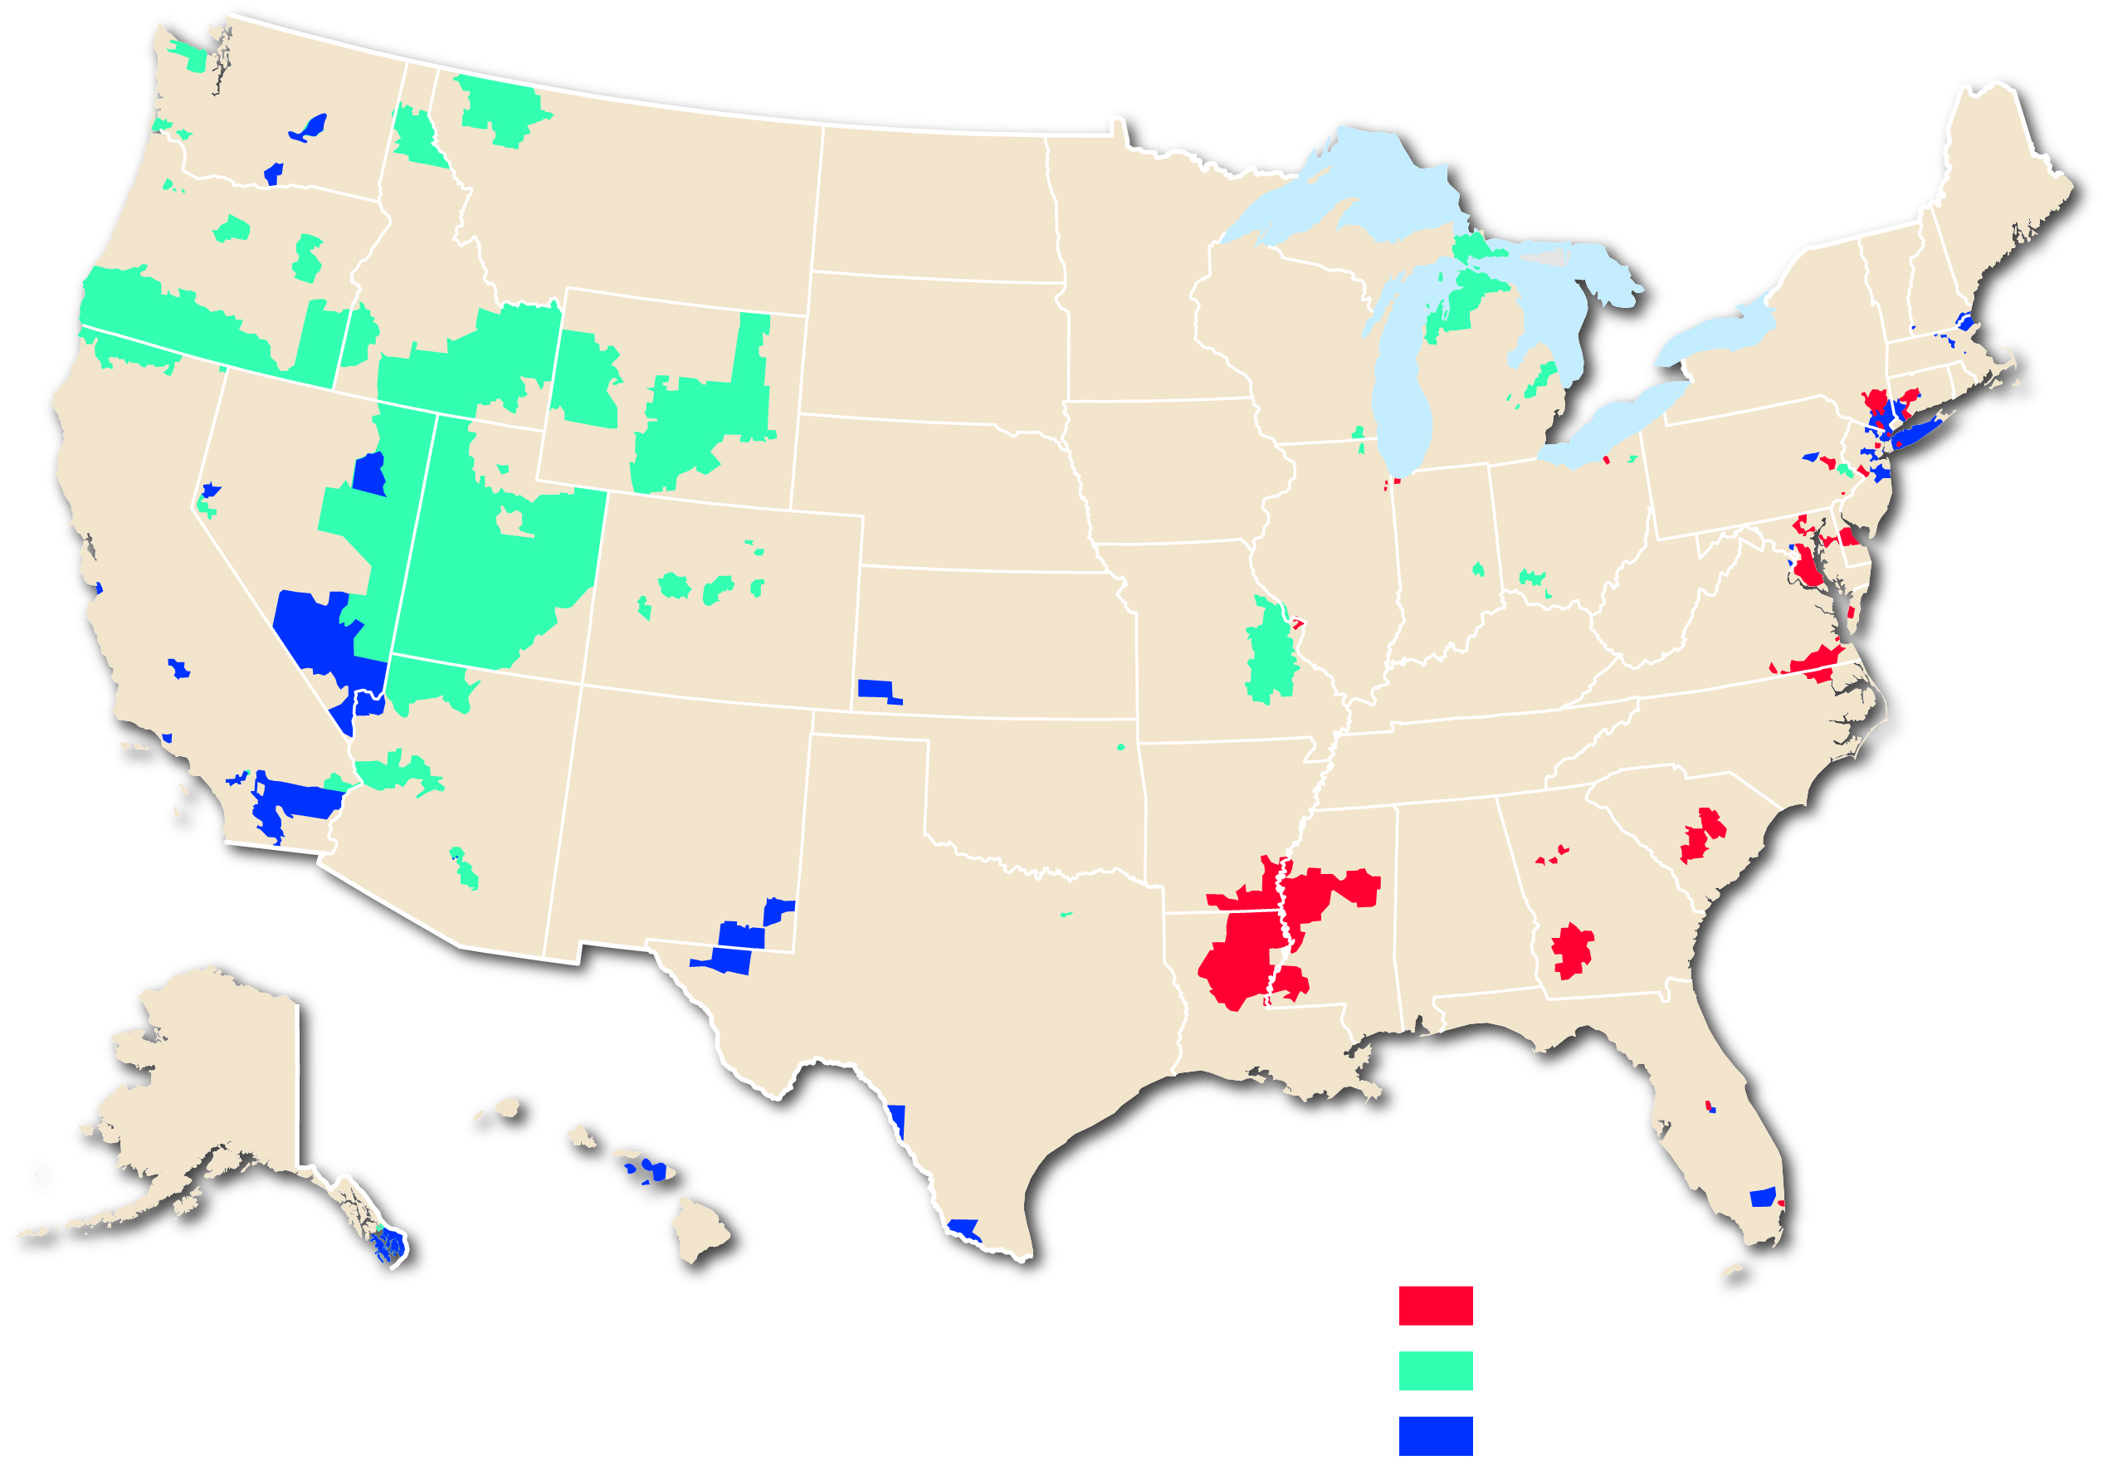
4.2.1 Origin and Diffusion of Folk and Popular Music (5 of 5)
Figure 4-16: Regional variations can be observed in popular music preferences.
Rihanna
Twenty One Pilots
Justin Bieber

Slide 20
4.2.2 Origin and Diffusion of Folk and Popular Sports (1 of 3)
Soccer is an example of global popular sport with folk origins
Ice hockey prevails in cold northern climates
Some sports have more distinct regional appeal such as cricket, wushu, lacrosse.
Baseball has its origins in the United States but has become popular in the Caribbean and Japan

Slide 21
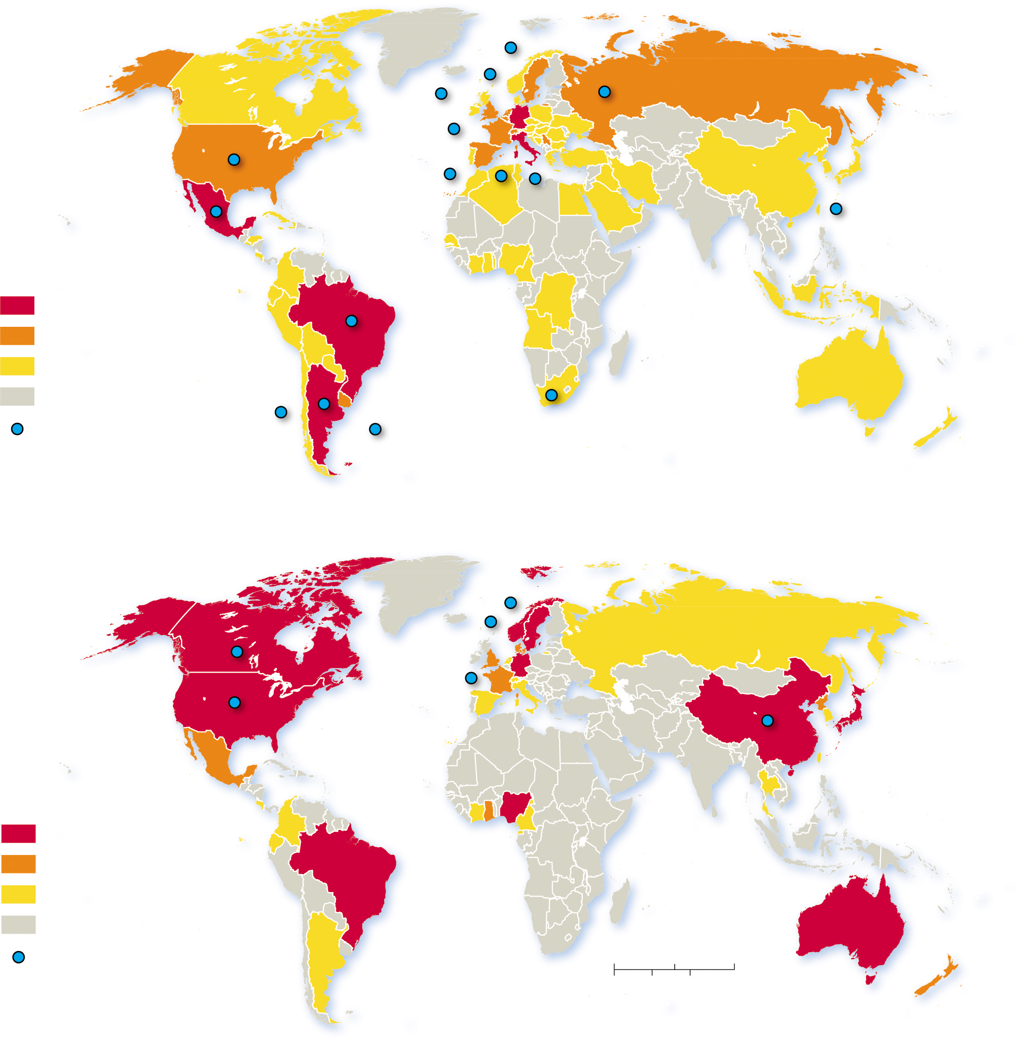
4.2.2 Origin and Diffusion of Folk and Popular Sports (2 of 3)
Figure 4-17: The World Cup has seen men’s and women’s teams qualify from all six inhabited continents.
(a) Men
Years qualified for
World Cup final round
15 and above
10–14
1–9
never qualified
Past host country
(b) Women
Years qualified for
World Cup final round
5 and above
3–4
1–2
never qualified
Past host country
0
1,500
3,000 Miles
0
1,500
3,000 Kilometers

Slide 22
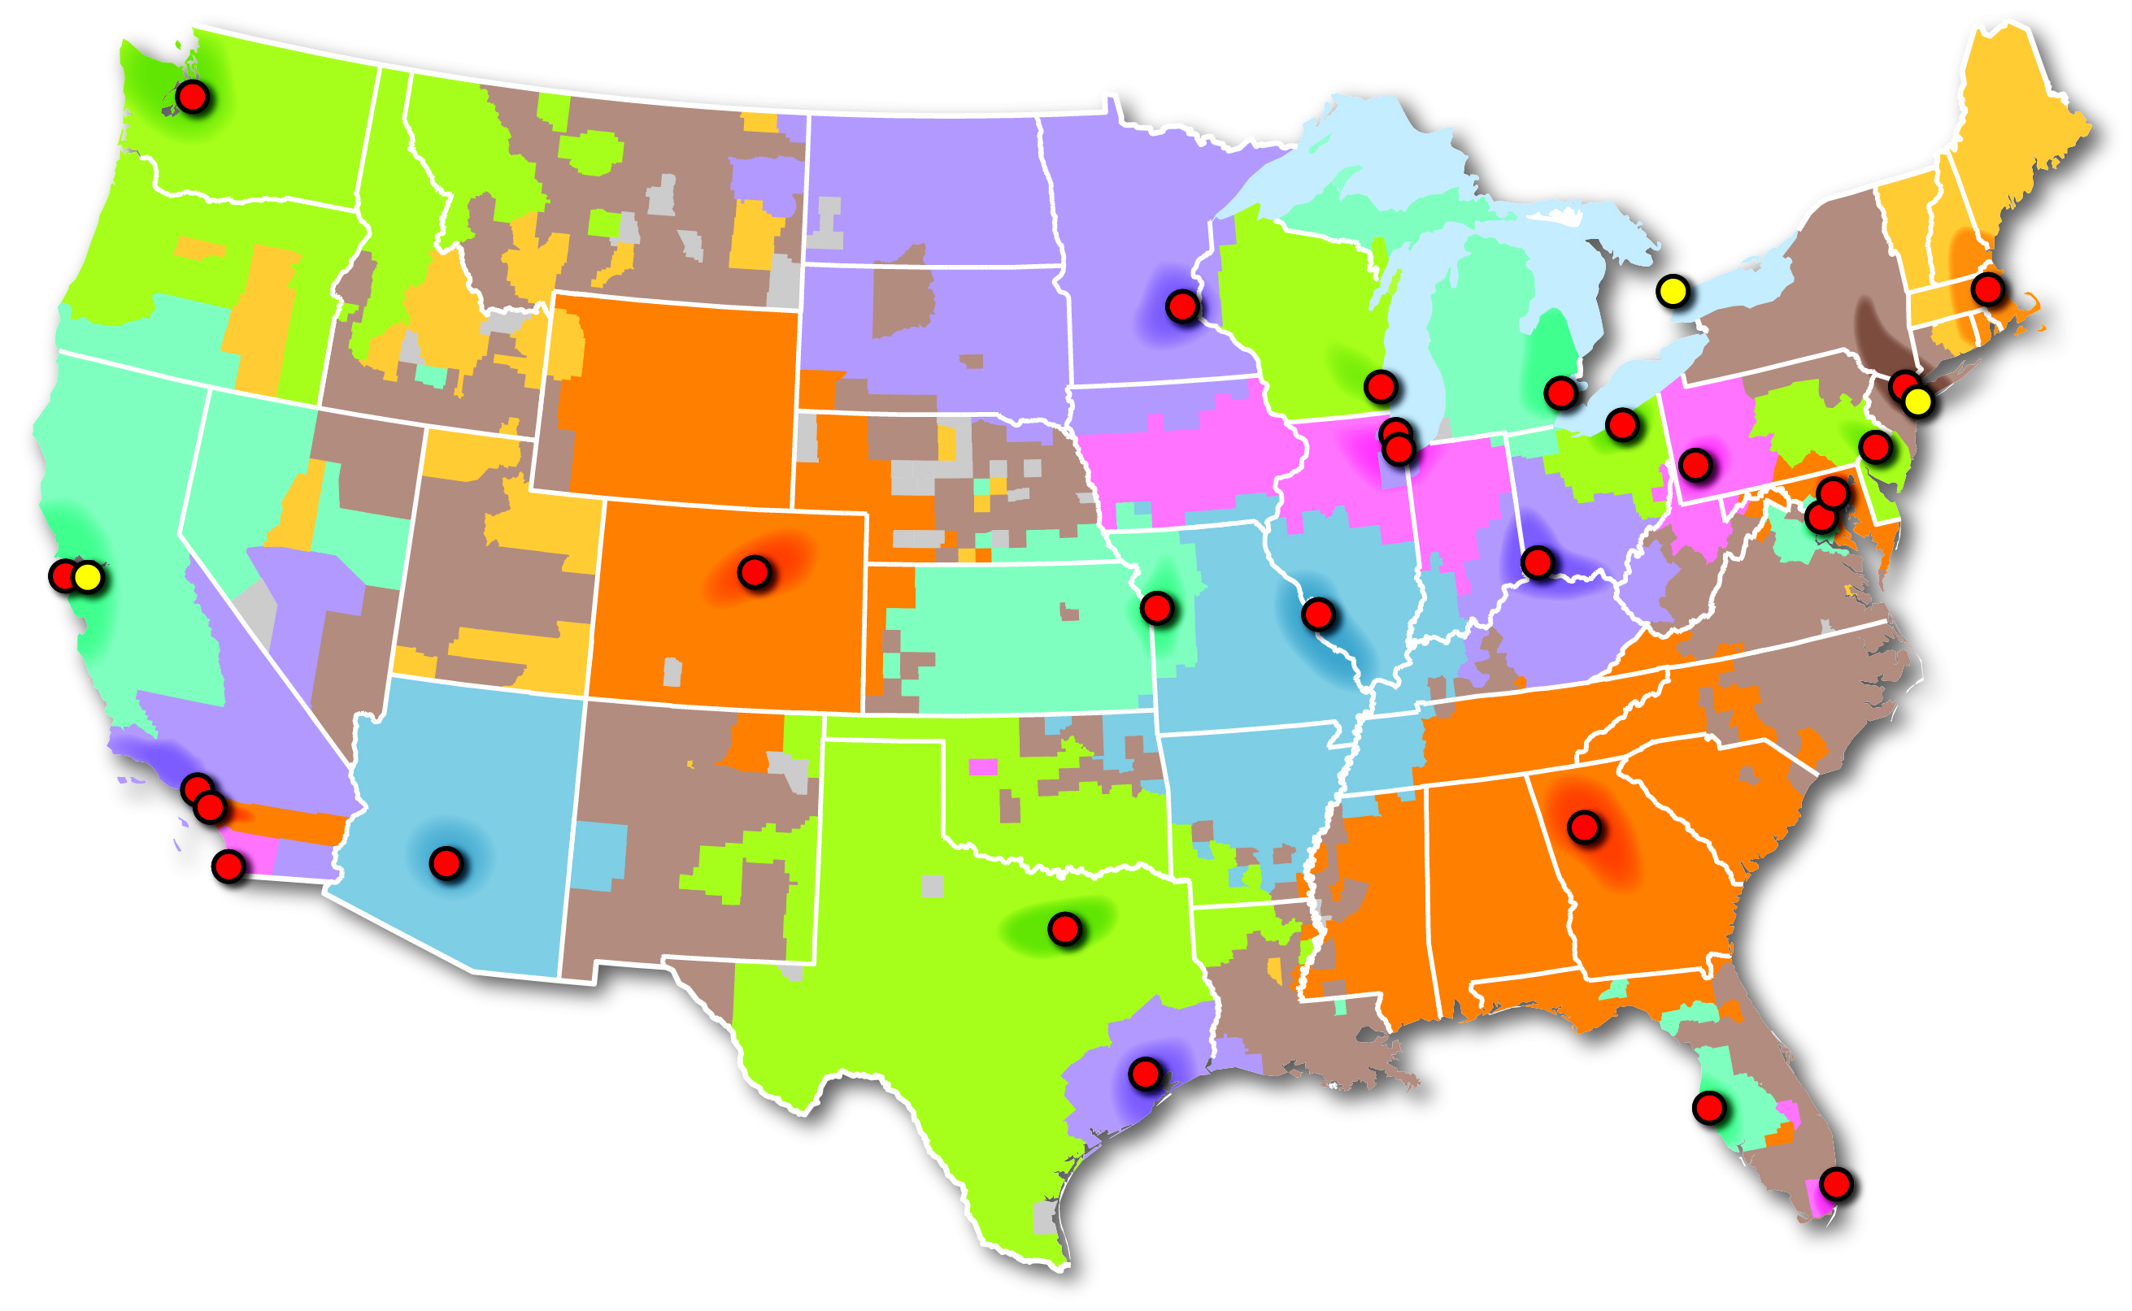
4.2.2 Origin and Diffusion of Folk and Popular Sports (3 of 3)
Figure 4-18: The area of support for a baseball team is an example of a functional region. The Yankees and Red Sox have support in regions far beyond the Northeast.
Mariners
Blue
Jays
Red
Sox
Twins
Brewers
Tigers
Yankees
Cubs
Indians
Pirates
Mets
White Sox
Phillies
Giants
Reds
Orioles
Athletics
Rockies
Royals
Nationals
Cardinals
Dodgers
Angels
Diamondbacks
Braves
Padres
Rangers
Astros
Rays
Marlins

Slide 23
4.2.3 Distribution of Folk and Popular Clothing (1 of 5)
Folk clothing may reflect environmental or cultural factors, including religious tradition
Popular clothing reflects occupation and income

Slide 24
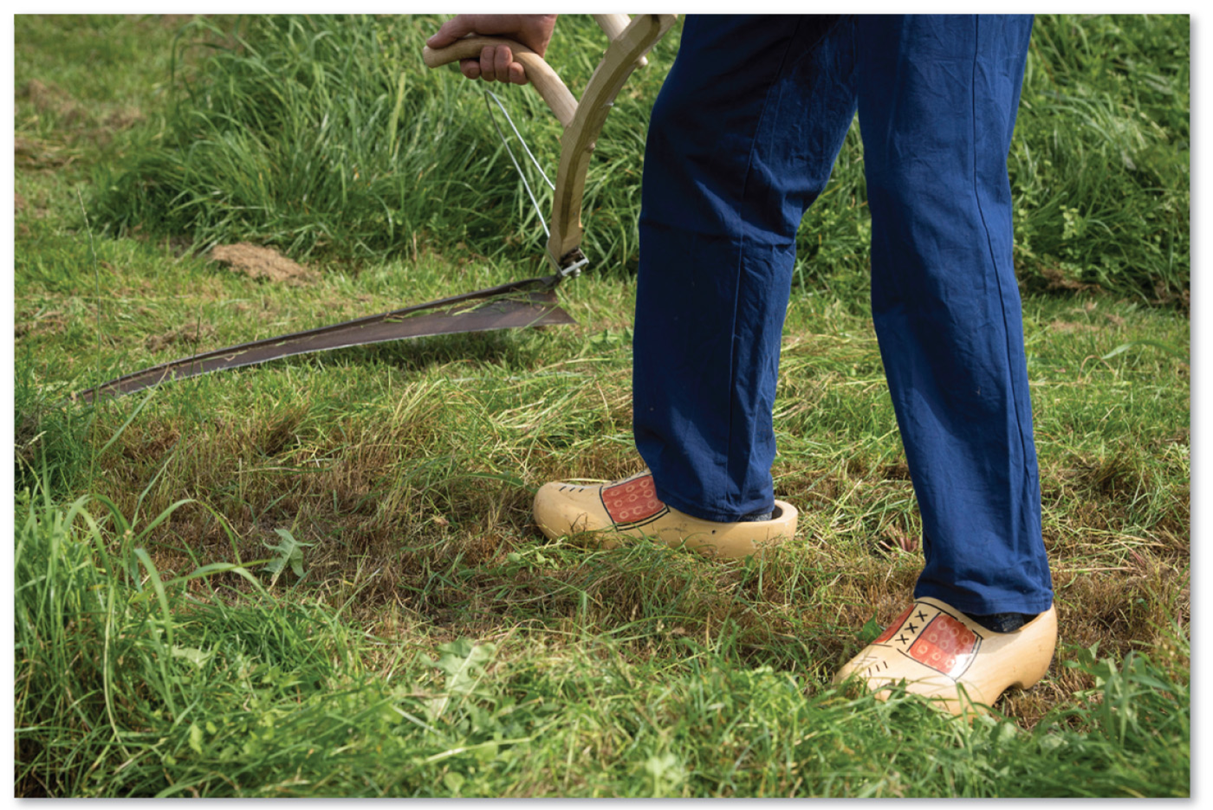
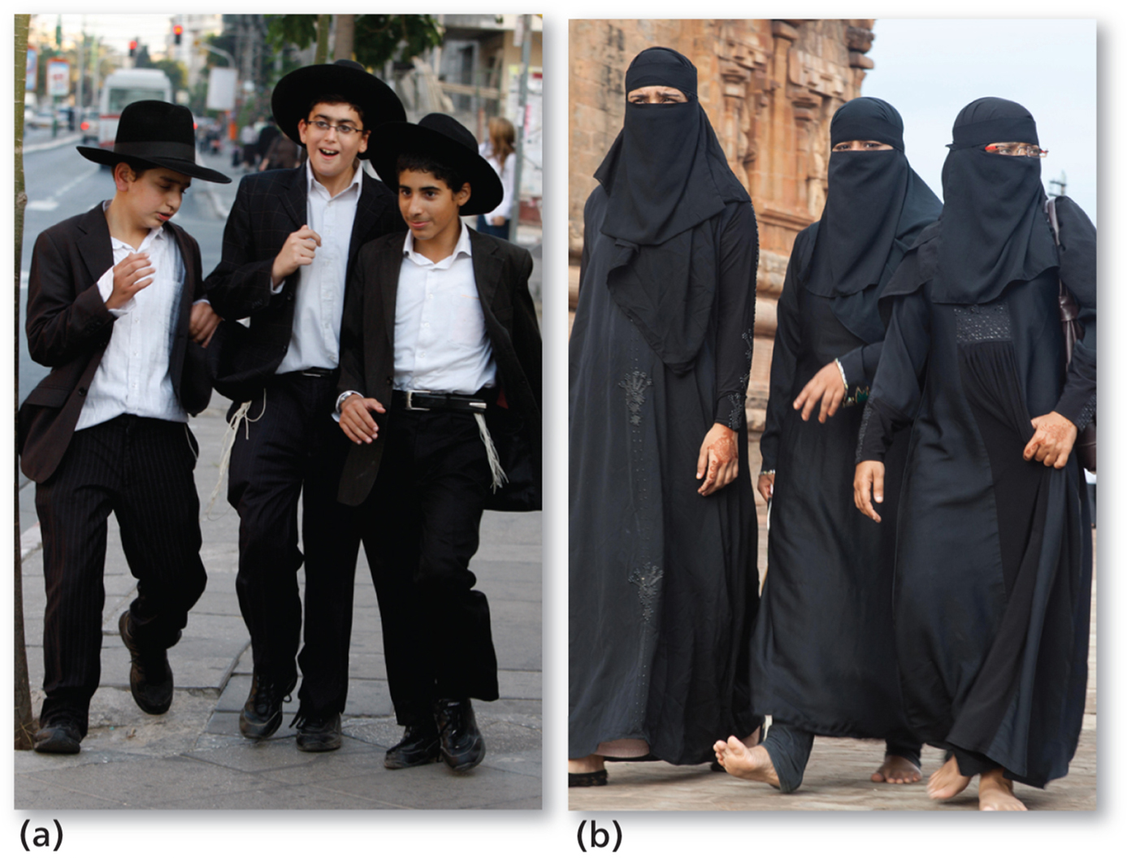
4.2.3 Distribution of Folk and Popular Clothing (2 of 5)
Figure 4-20: 4-20 and 4-21: Wooden shoes are a Dutch folk clothing custom (left). Jews (a) and Muslims (b) may customarily wear modest black clothes.
Figure 4-21: 4-20 and 4-21: Wooden shoes are a Dutch folk clothing custom (left). Jews (a) and Muslims (b) may customarily wear modest black clothes.

Slide 25
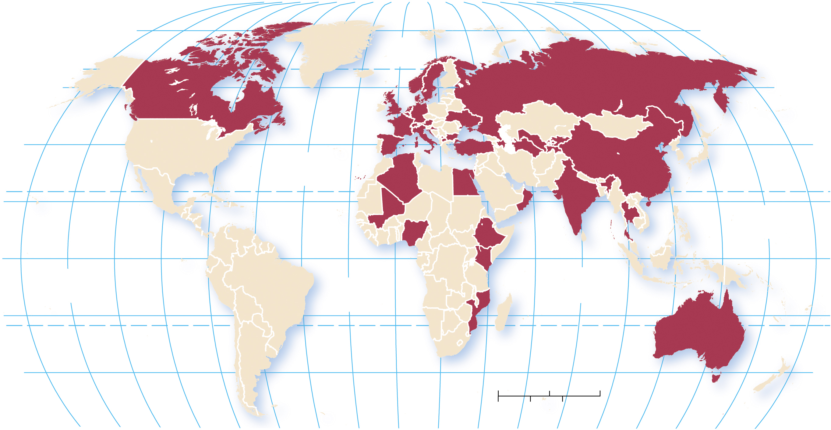
4.2.3 Distribution of Folk and Popular Clothing (3 of 5)
Figure 4-22: Countries in red had some level of government prevention of women from wearing religious attire in certain circumstances in 2012–2013.
80°
160°
140°
120°
100°
80°
60°
40°
20°
0°
20°
40°
60°
80°
100°
120°
140°
160°
180°
80°
ARCTIC
OCEAN
60°
60°
40°
40°
ATLANTIC
OCEAN
TROPIC OF CANCER
20°
PACIFIC
OCEAN
20°
0°
EQUATOR
0°
PACIFIC
OCEAN
ATLANTIC
OCEAN
INDIAN
OCEAN
20°
20°
TROPIC OF CAPRICORN
40°
0
1,500
3,000 Miles
40°
0
1,500
3,000 Kilometers
160°
140°
120°
100°
80°
60°
40°
20°
0°
20°
40°
60°
80°
100°
120°
140°
160°
180°

Slide 26
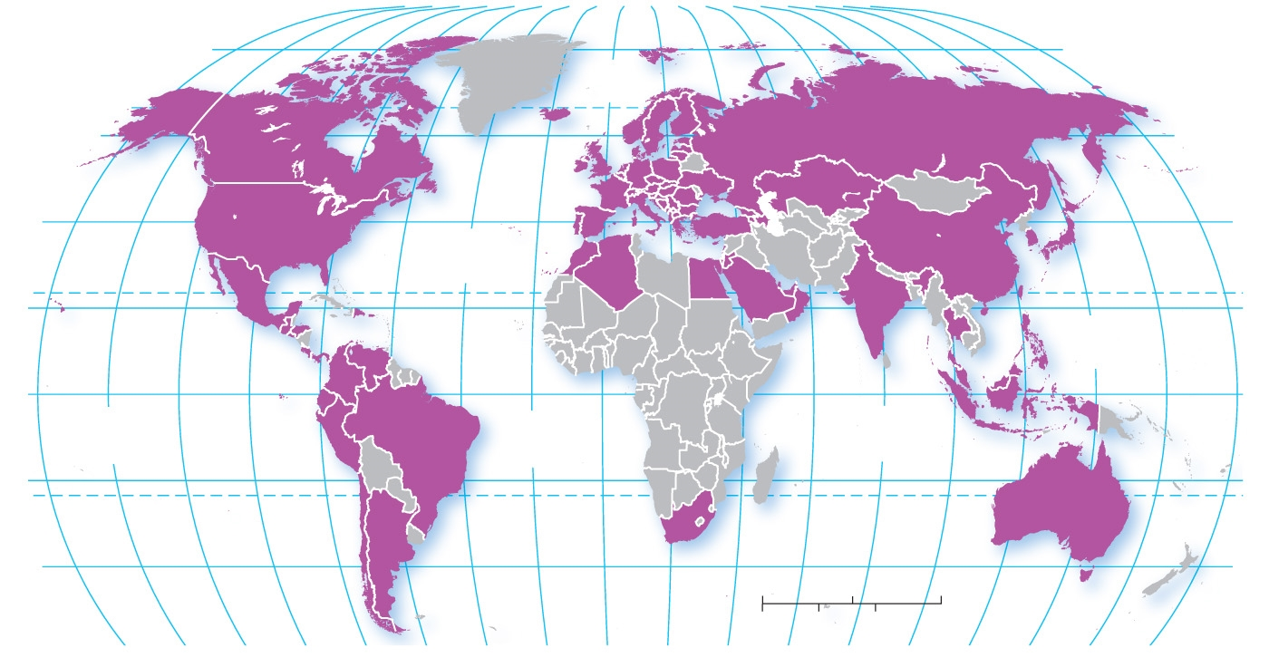
4.2.3 Distribution of Folk and Popular Clothing (4 of 5)
Figure 4-23: Zara is a popular clothing retailer with a global appeal.
160°
140°
120°
100°
80°
60°
40°
20°
0°
20°
40°
60°
80°
100°
120°
140°
160°
180°
80°
80°
ARCTIC
OCEAN
60°
60°
40°
40°
ATLANTIC
OCEAN
TROPIC OF CANCER
20°
20°
PACIFIC
OCEAN
0°
EQUATOR
0°
PACIFIC
OCEAN
ATLANTIC
OCEAN
INDIAN
OCEAN
20°
TROPIC OF CAPRICORN
20°
40°
0
1,500
3,000 Miles
40°
0
1,500
3,000 Kilometers
160°
140°
120°
100°
80°
60°
40°
20°
0°
20°
40°
60°
80°
100°
120°
140°
160°
180°

Slide 27
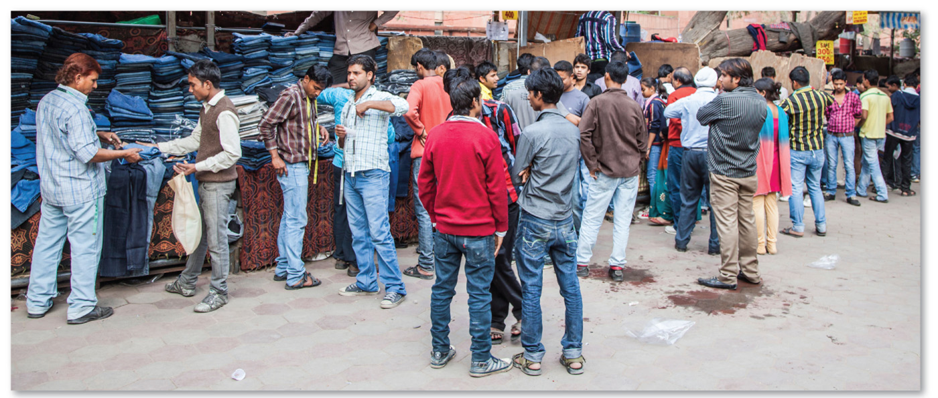
4.2.3 Distribution of Folk and Popular Clothing (5 of 5)
Figure 4-24: Blue jeans have a global appeal, as seen in this photo of men wearing jeans in Delhi.

Slide 28
4.2.4 Food Customs (1 of 3)
Local environmental conditions influence what can be grown
Food taboos may protect the local environment or serve other functions. Several major world religions have distinctive food taboos (e.g., Hindus do not consume meat, Jews and Muslims refrain from eating pork)
The contribution of a location’s distinctive physical features to the way food tastes is known as terroir

Slide 29
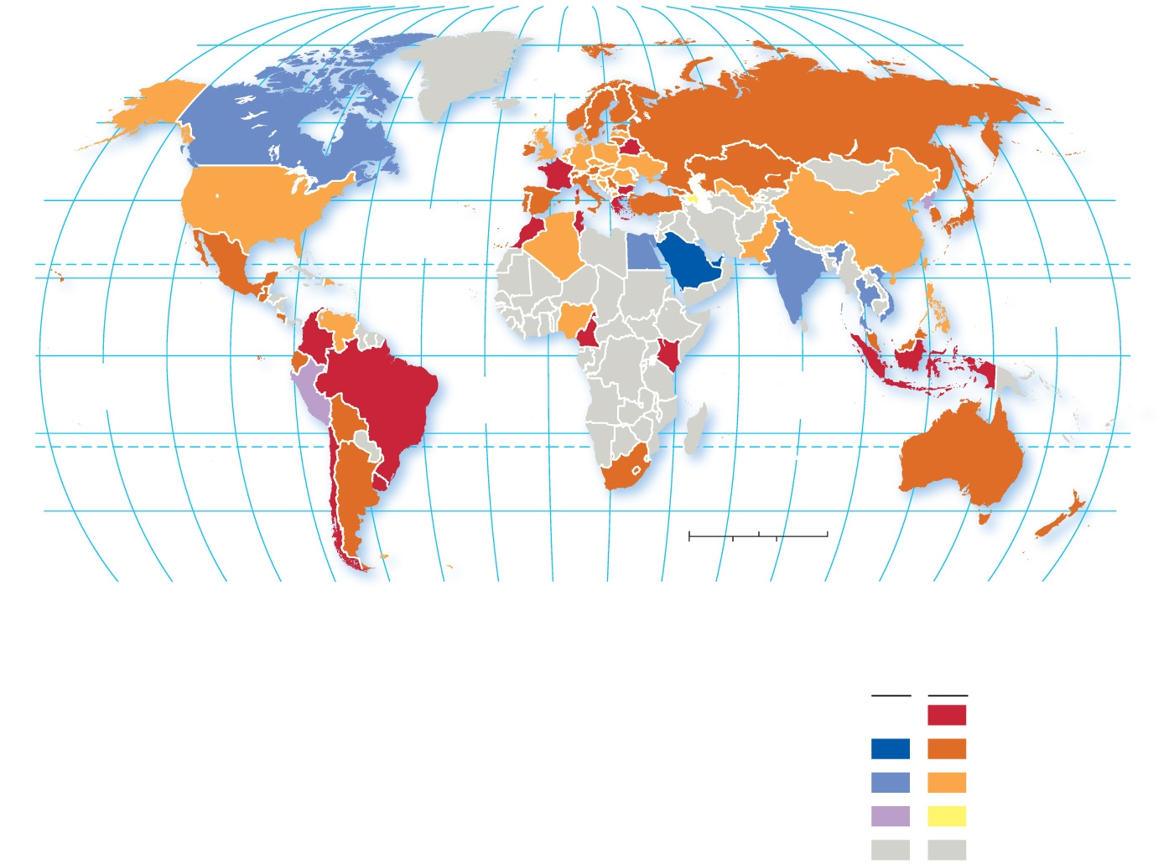
4.2.4 Food Customs (2 of 3)
Figure 4-26: Coca-Cola leads in sales in the United States, Latin America, Europe, and Russia. Pepsi leads in Canada, South Asia, and Southwest Asia.
80°
160°
140°
120°
100°
80°
60°
40°
20°
0°
20°
40°
60°
80°
100°
120°
140°
160°
180°
80°
ARCTIC
OCEAN
60°
60°
40°
ATLANTIC
OCEAN
40°
20°
TROPIC OF CANCER
20°
PACIFIC
OCEAN
0°
PACIFIC
OCEAN
EQUATOR
0°
ATLANTIC
OCEAN
INDIAN
OCEAN
20°
TROPIC OF CAPRICORN
20°
40°
0
1,500
3,000 Miles
40°
0
1,500
3,000 Kilometers
160°
140°
120°
100°
80°
60°
40°
20°
0°
20°
40°
60°
80°
100°
120°
140°
160°
180°
Percent market share
held by leading soft drink
Pepsi
Coke
75 and above
50–74
25–49
below 25
no data

Slide 30
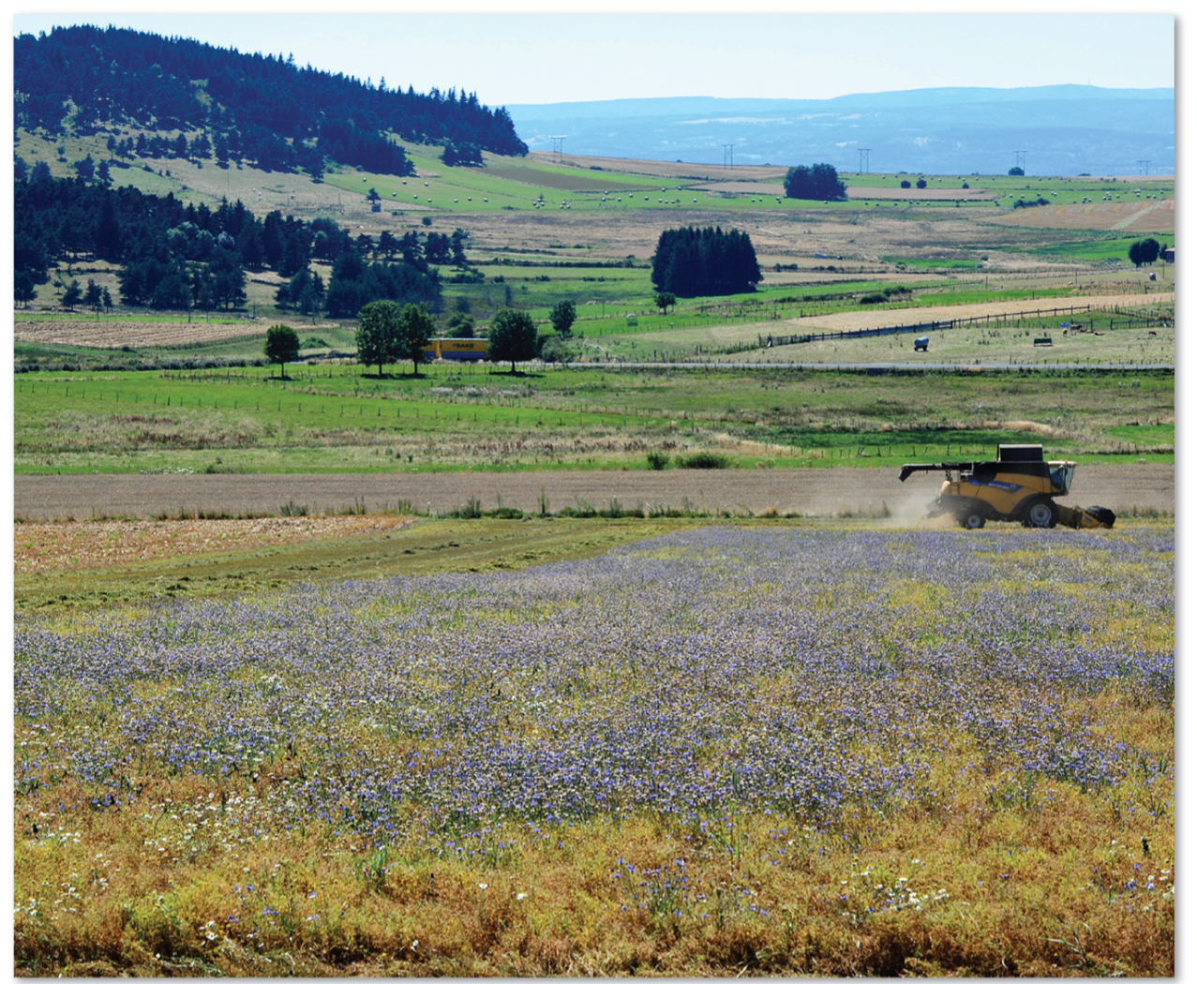
4.2.4 Food Customs (3 of 3)
Figure 4-27: A field of green lentils is being harvested outside the village of Le Puy, France.

Slide 31
4.2.5 Folk and Popular Housing (1 of 5)
Folk housing can have
environmental influences—choice of building materials, climate considerations
cultural influences—beliefs about shape and orientation of house
U.S. folk housing styles diffused from three hearths on the Atlantic coast.
New England
Middle Atlantic
Lower Chesapeake and Tidewater

Slide 32
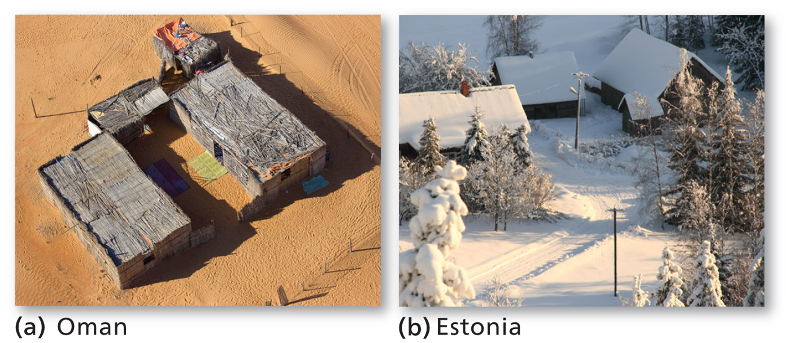
4.2.5 Folk and Popular Housing (2 of 5)
Figure 4-28: Different environmental conditions influence the preferred style of house in Oman (left) and Estonia (right).
(a) Oman
(b) Estonia

Slide 33
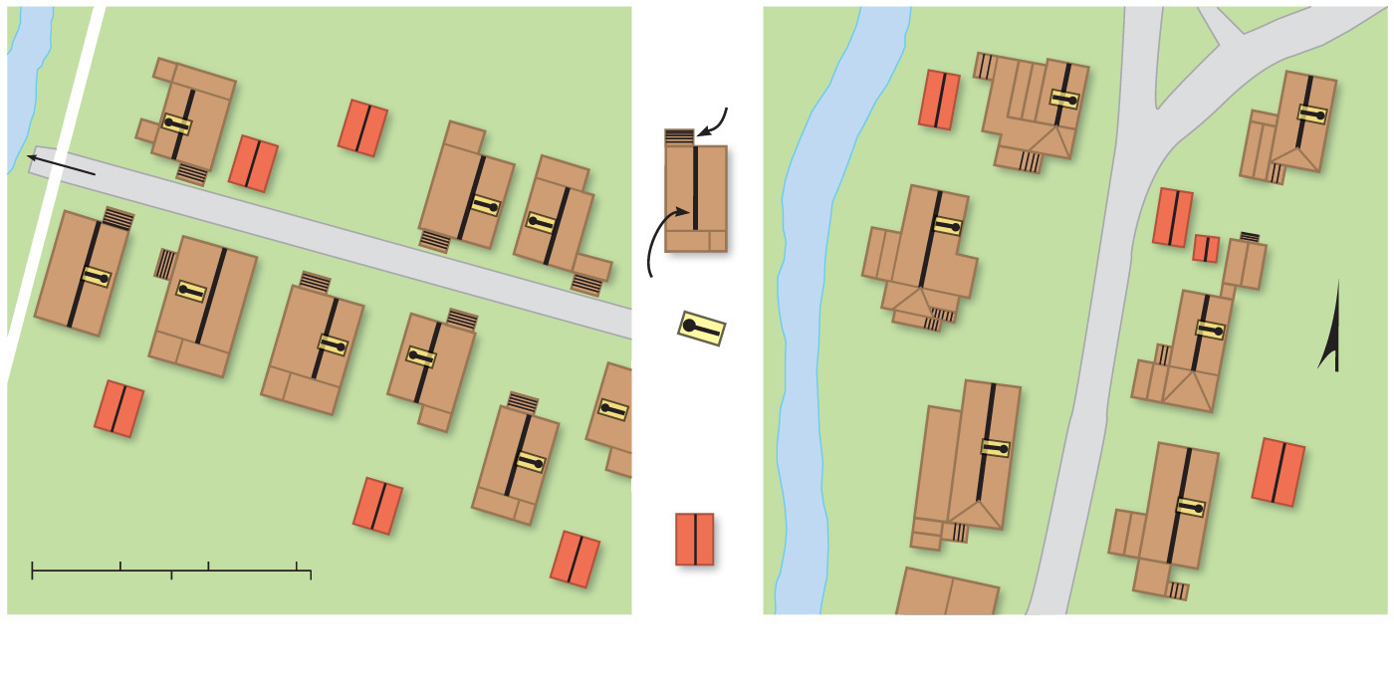
4.2.5 Folk and Popular Housing (3 of 5)
Figure 4-29: Different beliefs affect the form and position of houses in Laos (a) and Thailand (b).
Houses
Front steps
and entrance
150 meters (500 feet) between the houses and the river
Ridgepole
Direction of sleeping
N
Sheds and
farm buildings
0
10
20
30 Meters
0
50
100 Feet
(a) Muang Nan, Laos
(b) Ban Mae Sakud, Thailand

Slide 34
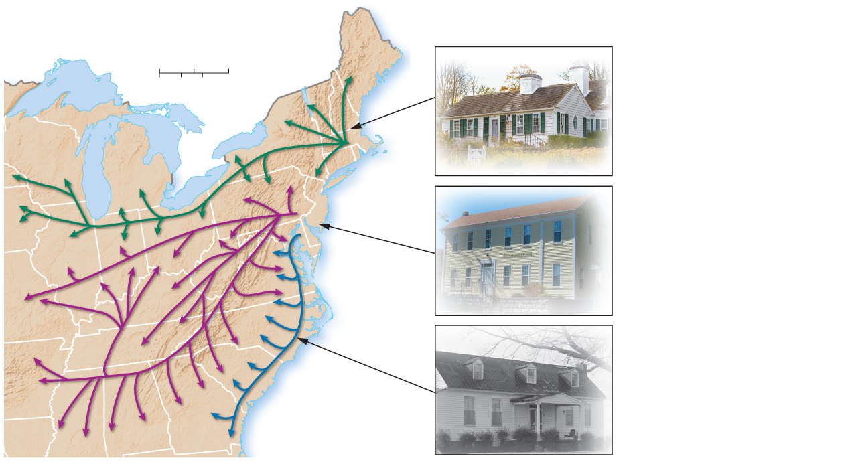
4.2.5 Folk and Popular Housing (4 of 5)
Figure 4-30: Three styles of folk housing can be traced from their origin on the Atlantic coast.
New England. The distinctive style was box
shaped with a central hall. The New England
house types can be found throughout the Great
Lakes region as far west as Wisconsin because
this area was settled primarily by migrants
from New England.
0
1,500
3,000 Miles
0
1,500
3,000 Kilometers
New
England
Middle
Atlantic
Middle Atlantic. The principal house type
was known as the “I”- house, typically two full stories in height, one room deep and at least two rooms wide. Middle Atlantic migrants carried their house type westward across
the Ohio Valley and southwestward along the Appalachian trails.
Lower
Chesapeake
and Tidewater
Lower Chesapeake/Tidewater. The style typically comprised one story, with a steep roof and chimneys at either end. Migrants spread these houses from the Chesapeake Bay and Tidewater, Virginia, area along the Southeast Coast. In wet areas, houses in the coastal southeast were often raised on piers or on
brick foundations.
ATLANTIC
OCEAN

Slide 35
4.2.5 Folk and Popular Housing (5 of 5)
Figure 4-31: Similar Tudor style house in (a) Chicago suburb and (b) New York suburb. Houses in the English Tudor style were especially popular in affluent suburbs during the 1970s.
(a) Chicago suburb
(b) New York suburb

Slide 36
Key Issue 3: Why Is Access to Culture Unequal?
4.3.1 Electronic Diffusion of Culture
4.3.2 Social Media and Interconnectivity
4.3.3 Challenges in Accessing Electronic Media
4.3.4 Spatial Dimensions to Cyberattacks

Slide 37
4.3.1 Electronic Diffusion of Culture (1 of 7)
Television ownership was relatively high in the United States in the1950s. The United States had 86% of the world’s T V sets in 1954
T V had diffused to Europe by 1970, but most of Africa and Asia had little T V broadcasting
Near-universal T V access by the start of the 21st century

Slide 38
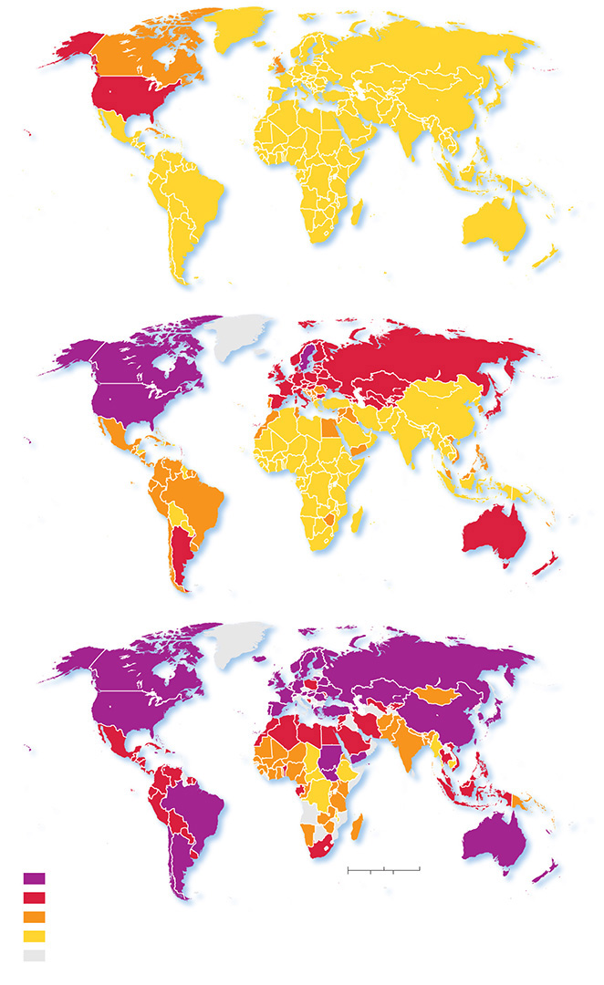
4.3.1 Electronic Diffusion of Culture (2 of 7)
Figure 4-32: TVs per 1,000 population in (a) 1954, (b) 1970, and (c) 2005.
(a) 1954
(b) 1970
(c) 2005
TVs per 1,000
population
1,500
3,000 Miles
300 and above
0
100–299
0
1,500
3,000 Kilometers
10–99
below 10
no data

Slide 39
4.3.1 Electronic Diffusion of Culture (3 of 7)
Table 4-1: The number of televisions in the United States continues to increase but the percent of the global share within the United States continues to decrease.
Blank | 1954 | 1970 | 2005
Density: Number of U.S. T Vs (million) | 32 | 82 | 219
U.S. diffusion: T Vs per 1,000 population | 196 | 395 | 882
Global diffusion: U.S. share of world T Vs (%) | 86 | 25 | 16

Slide 40
4.3.1 Electronic Diffusion of Culture (4 of 7)
Table 4-2: The number of Internet users in the United States continues to increase but the global share of Internet users within the United States continues to decrease.
Blank | 1995 | 2000 | 2017
Density: Number of U.S. Internet users (million) | 25 | 124 | 287
U.S. diffusion: Internet users per 1,000 population | 94 | 441 | 886
Global diffusion: U.S. share of world’s Internet users (%) | 63 | 35 | 7

Slide 41
4.3.1 Electronic Diffusion of Culture (5 of 7)
Most countries did not have Internet service in 1995. The United States had 63% percent of the world’s users
U.S. Internet use increased rapidly between 1995 and 2000, from 9% to 44% of the population, but the worldwide increase was much greater. The share of the world’s Internet users clustered in the United States declined from 63% to 35%

Slide 42
4.3.1 Electronic Diffusion of Culture (6 of 7)
Internet usage continued to increase rapidly in the United States between 2000 and 2017, to more than 75% of the population, but the share of the world’s Internet users found in the United States continued to decline to 7% in 2017. China now accounts for 22% of the world’s Internet users

Slide 43
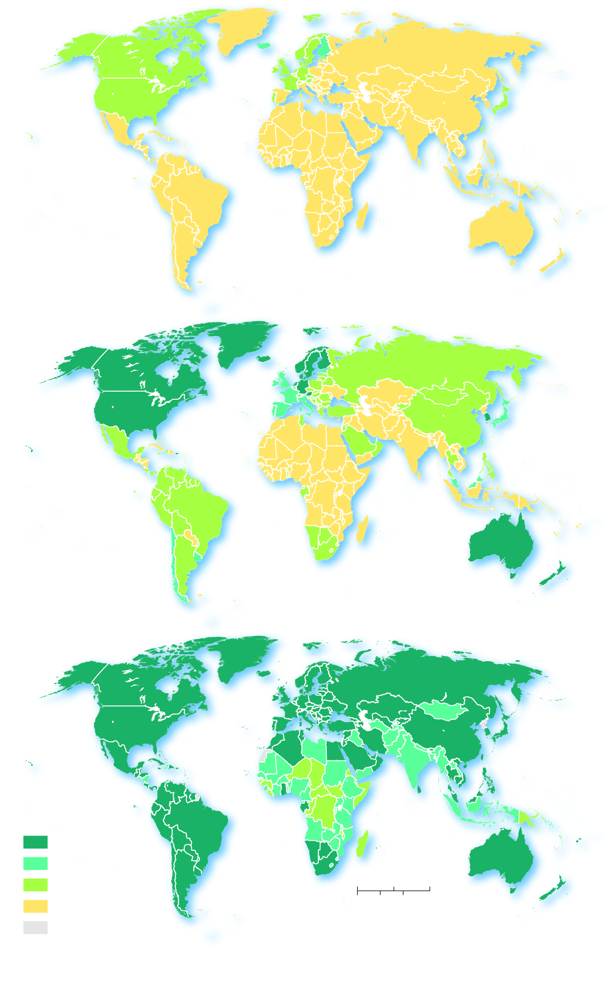
4.3.1 Electronic Diffusion of Culture (7 of 7)
Figure 4-33: Internet users per 1,000 population in (a) 1995, (b) 2000, and (c) 2017.
(a) 1995
(b) 2000
(c) 2017
Internet users per
1,000 population
300 and above
100–299
0
1,500
3,000 Miles
10–99
0
1,500
3,000 Kilometers
below 10
no data

Slide 44
4.3.2 Social Media and Interconnectivity (1 of 4)
The origin of social media (Facebook, Instagram, Twitter) has followed the same pattern of other electronic media, with the number of users growing in the United States, while the U.S. share of social media users declines as the technology spreads across the globe

Slide 45
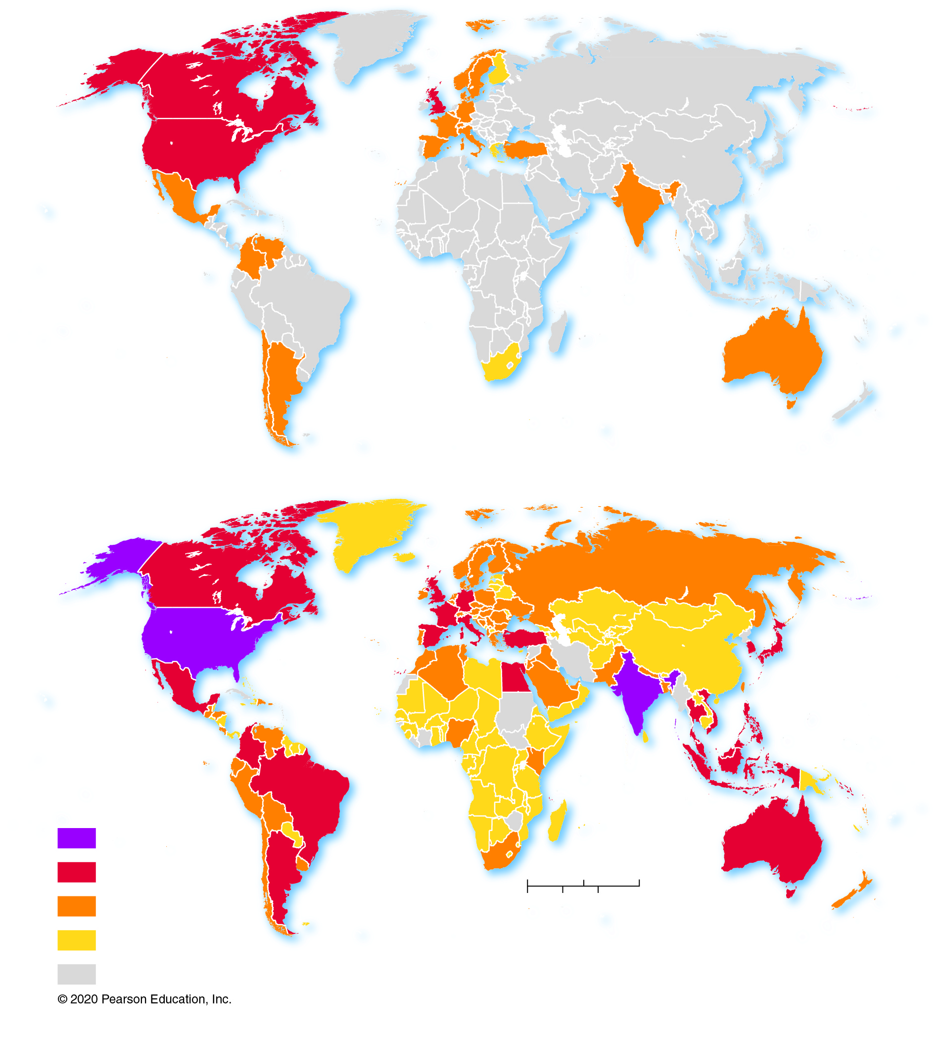
4.3.2 Social Media and Interconnectivity (2 of 4)
Figure 4-34: Facebook users per millions in (a) 2008 and (b) 2018.
(a) 2008
(b) 2018
Facebook users
(millions)
100 and above
10–99
0
1,500
3,000 Miles
1–9
0
1,500
3,000 Kilometers
below 1
no data

Slide 46
4.3.2 Social Media and Interconnectivity (3 of 4)
Table 4-3: The number of social media users in the United States continues to increase but the global share of American social media users continues to decrease.
Blank | Facebook 2009 | Facebook 2017 | Twitter 2009 | Twitter 2017 | Instagram 2009 | Instagram 2017
Density: Number of U.S. users (millions) | 55 | 185 | 7 | 72 | 0 | 120
U.S. diffusion: Internet users per 1,000 population | 179 | 569 | 22 | 221 | 0 | 375
Global diffusion: U.S. share of world’s users (%) | 34 | 11 | 51 | 23 | 0 | 15

Slide 47
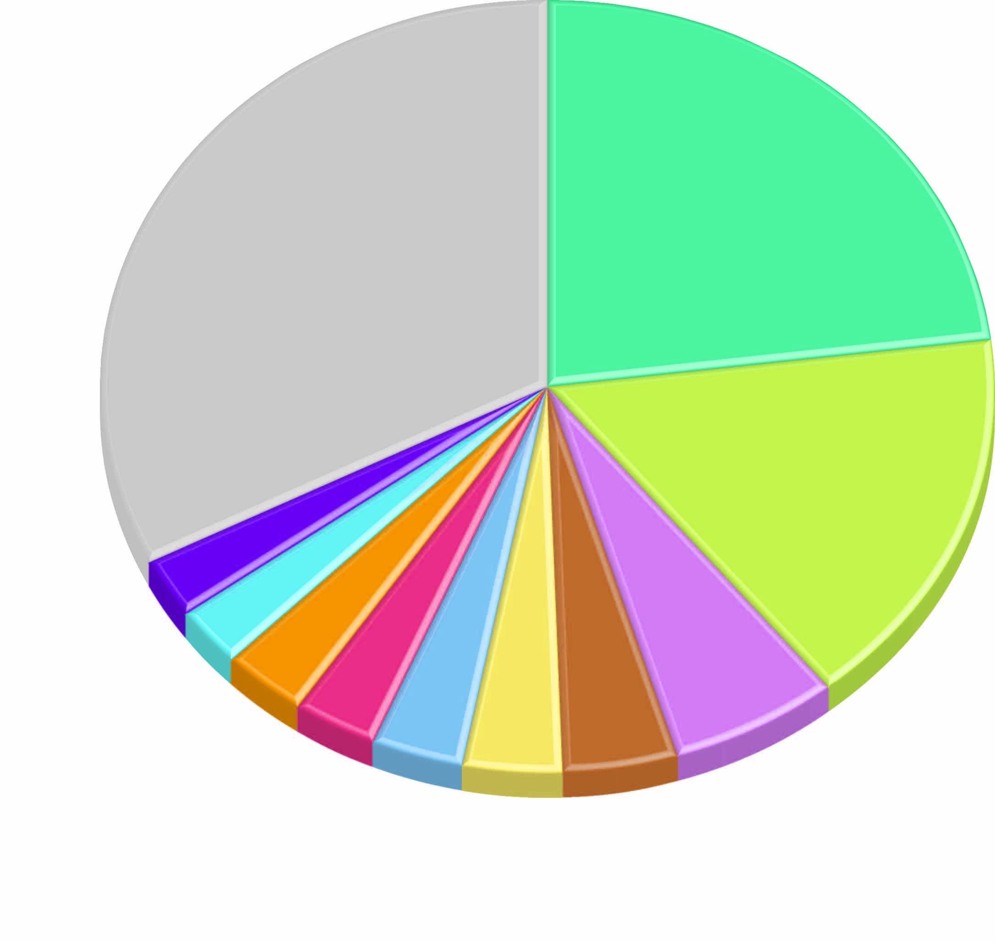
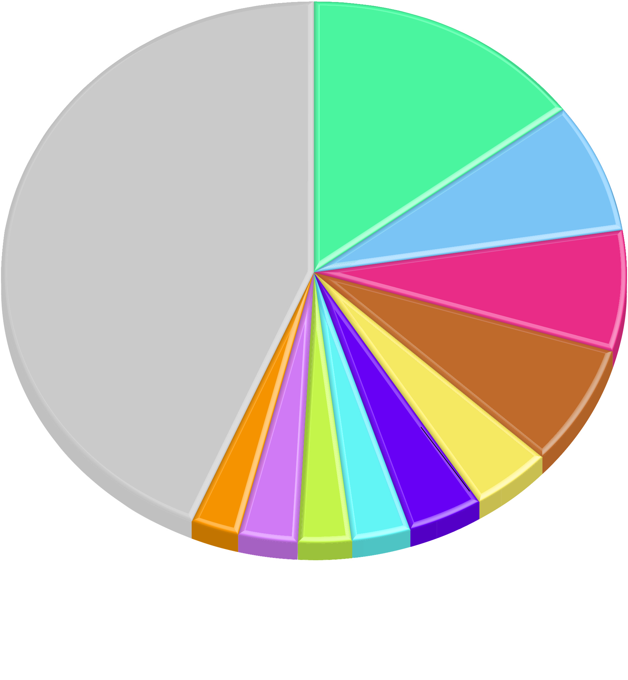
4.3.2 Social Media and Interconnectivity (4 of 4)
Figure 4-36: The United States dominates the use of Twitter and Instagram.
Figure 4-37: The United States dominates the use of Twitter and Instagram.
United States
Other
United States
15%
32%
23%
Brazil
8%
Other
44%
India
Japan
7%
16%
Indonesia
France
7%
2%
United
Kingdom
Spain
6%
Turkey
3%
Mexico
4%
3%
India
Brazil
Mexico
Russia
3%
3%
Turkey
Saudi
Arabia
3%
United
Kingdom
Japan
Iran
4%
3%
3%
3%
4%
3%

Slide 48
4.3.3 Challenges in Accessing Electronic Media (1 of 3)
Many governments are concerned with their citizen’s use of social media
Control use by banning or limiting technology
Censor or filter Internet content
Harass or punish users
China, Russia, and Iran are notorious for violating the rights of individuals in order to exert government control over the access to social media and content

Slide 49
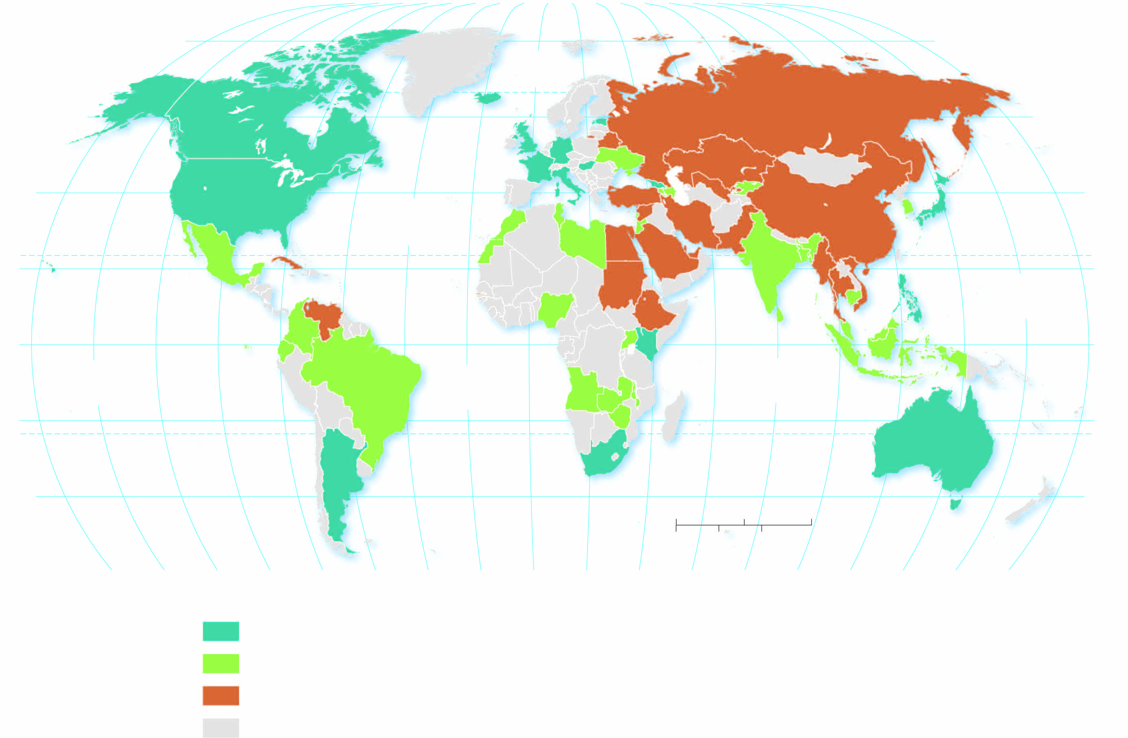
4.3.3 Challenges in Accessing Electronic Media (2 of 3)
Figure 4-40: Different governments around the world limit user’s use and access to technology, or violate their personal rights with respect to electronic media.
80°
160°
140°
120°
100°
80°
60°
40°
20°
0°
20°
40°
60°
80°
100°
120°
140°
160°
180°
80°
ARCTIC
OCEAN
60°
60°
40°
ATLANTIC
OCEAN
40°
20°
TROPIC OF CANCER
20°
PACIFIC
OCEAN
0°
EQUATOR
0°
PACIFIC
OCEAN
ATLANTIC
OCEAN
INDIAN
OCEAN
20°
TROPIC OF CAPRICORN
20°
40°
0
1,500
3,000 Miles
40°
160°
140°
120°
100°
80°
60°
40°
20°
0°
20°
40°
0
60°
1,500
3,000 Kilometers
80°
100°
120°
140°
160°
180°
Internet freedom
free
partly free
not free
no data

Slide 50
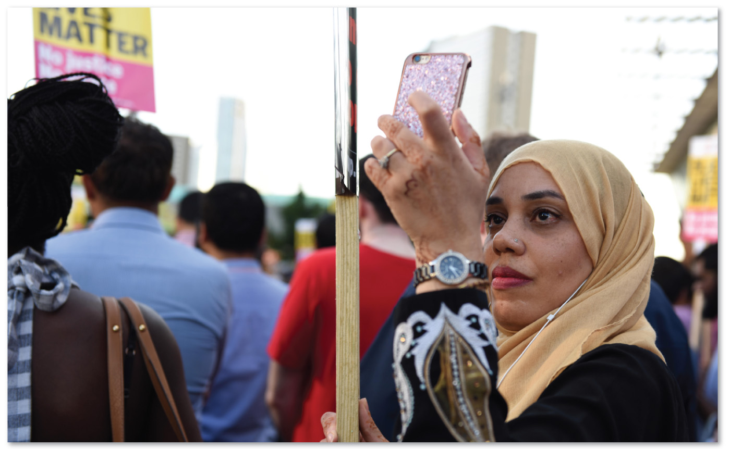
4.3.3 Challenges in Accessing Electronic Media (3 of 3)
Figure 4-42: Recording a demonstration in London in 2017.

Slide 51
4.3.4 Spatial Dimensions to Cyberattacks (1 of 7)
A cyberattack can take on many different forms:
Malware is hostile software designed to cause intentional harm
Ransomware encrypts the victim’s files, making them inaccessible, until a ransom is paid to decrypt them
Cyber espionage is the deployment of a virus to observe and/or destroy data in the computer system of a government agency or large corporation

Slide 52
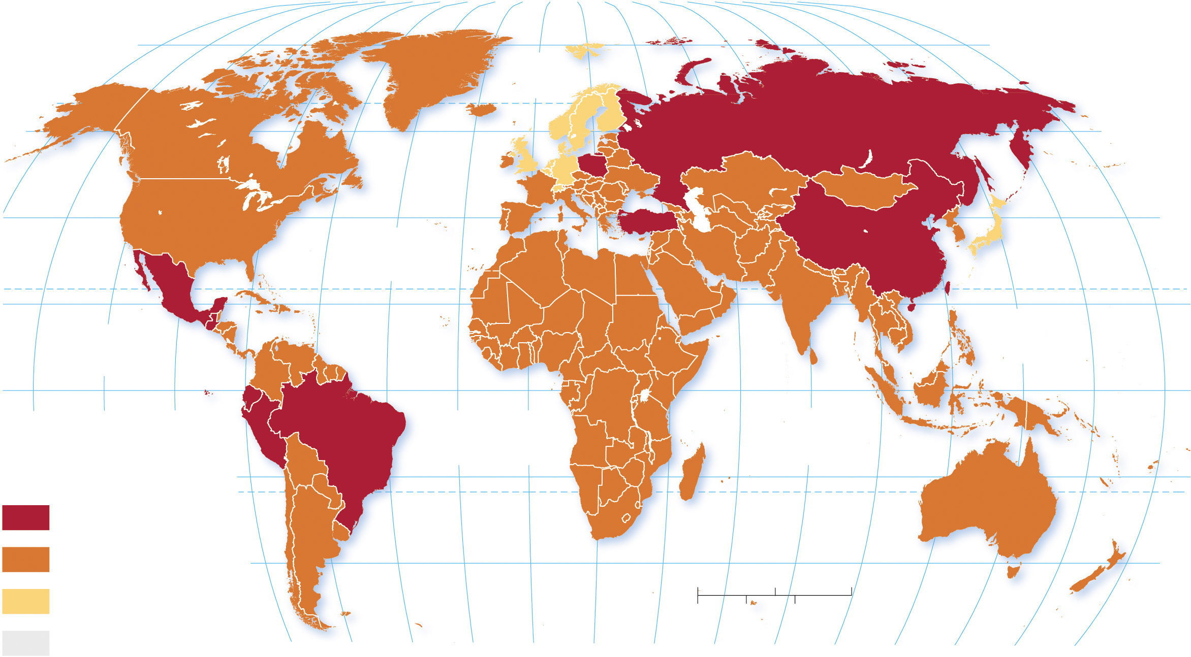
4.3.4 Spatial Dimensions to Cyberattacks (2 of 7)
Figure 4-43: Malware infections are found globally.
160°
140°
120°
100°
80°
60°
40°
20°
0°
20°
40°
60°
80°
100°
120°
140°
160°
180°
80°
80°
ARCTIC
OCEAN
60°
60°
40°
ATLANTIC
OCEAN
40°
TROPIC OF CANCER
20°
PACIFIC
OCEAN
20°
PACIFIC
OCEAN
0°
EQUATOR
0°
140°
120°
100°
ATLANTIC
OCEAN
INDIAN
OCEAN
Malware
infection (%)
20°
20°
33 and above
TROPIC OF CAPRICORN
25–32
40°
0
1,500
3,000 Miles
40°
below 25
0
1,500
3,000 Kilometers
no data
80°
60°
40°
20°
0°
20°
40°
60°
80°
100°
120°
140°
160°
180°

Slide 53
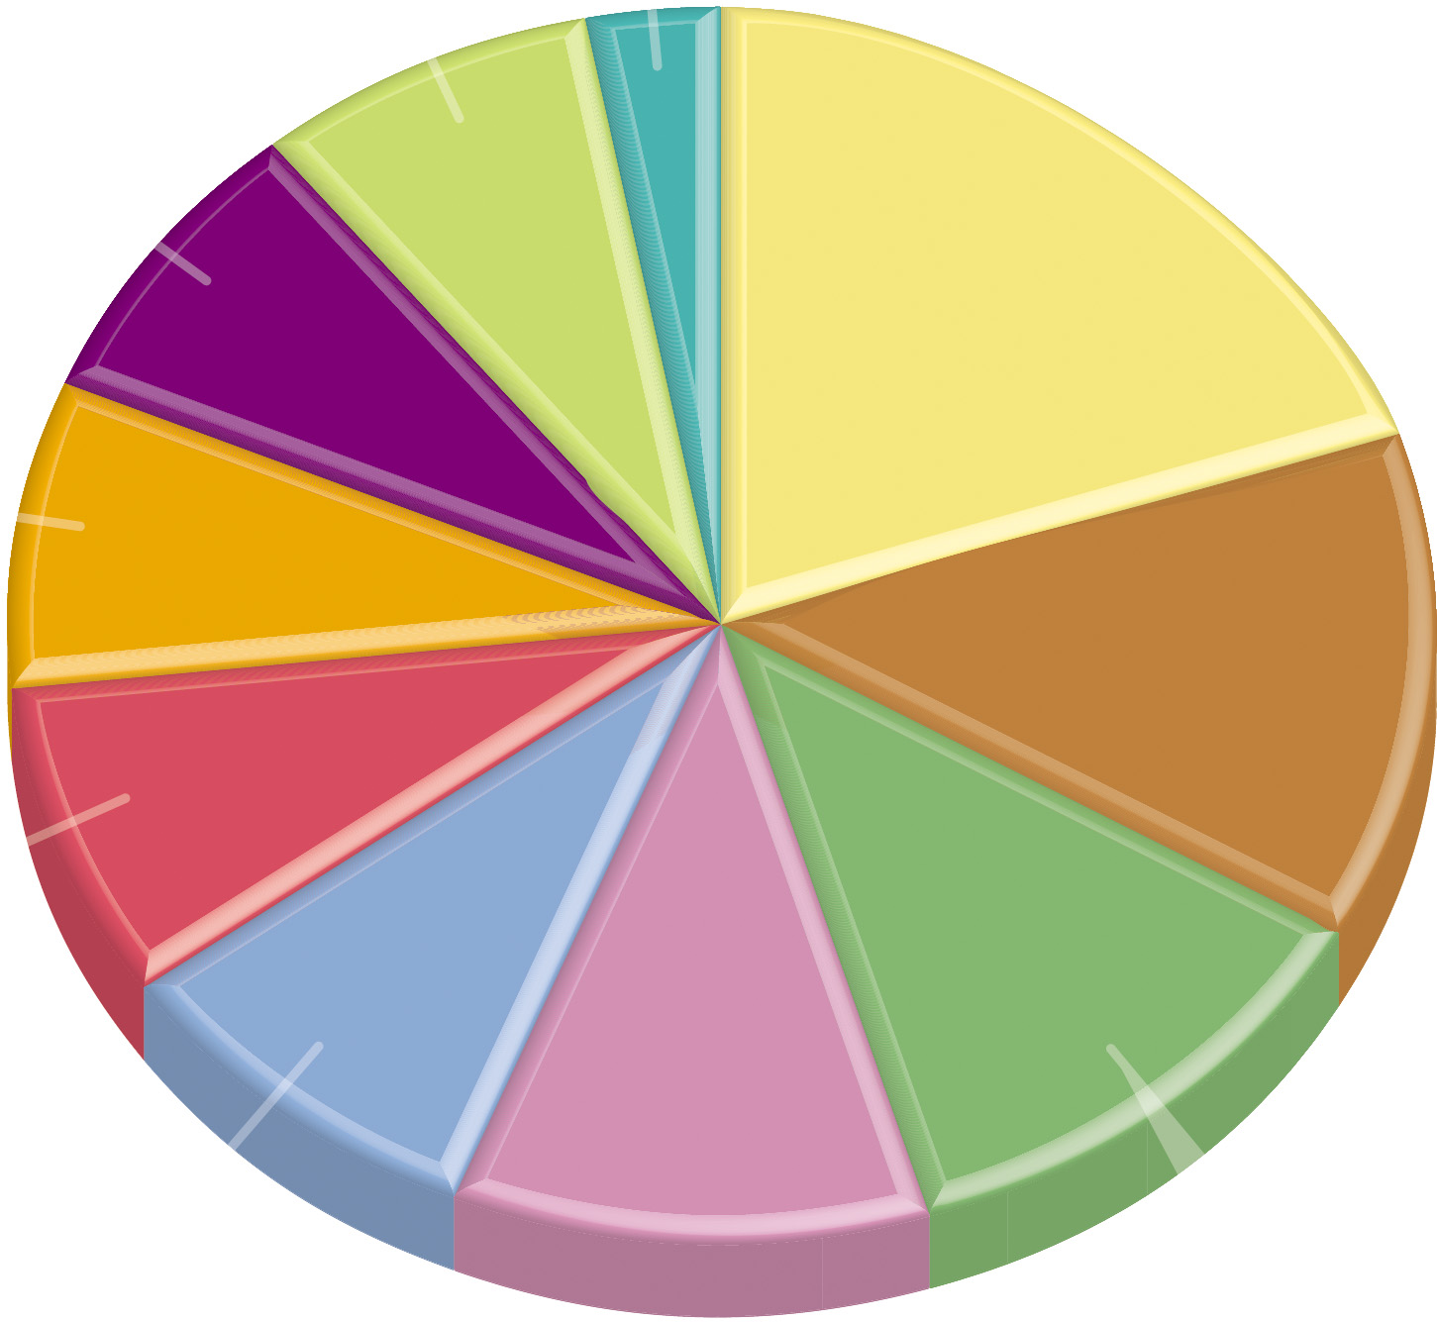
4.3.4 Spatial Dimensions to Cyberattacks (3 of 7)
Figure 4-44: Americans are the most common victim of cyberattacks.
United States
Ukraine
4%
1%
Brazil
4%
India
10%
Algeria
4%
Russia
6%
Vietnam
4%
Italy
5%
Germany
4%
Kazakhstan
6%

Slide 54
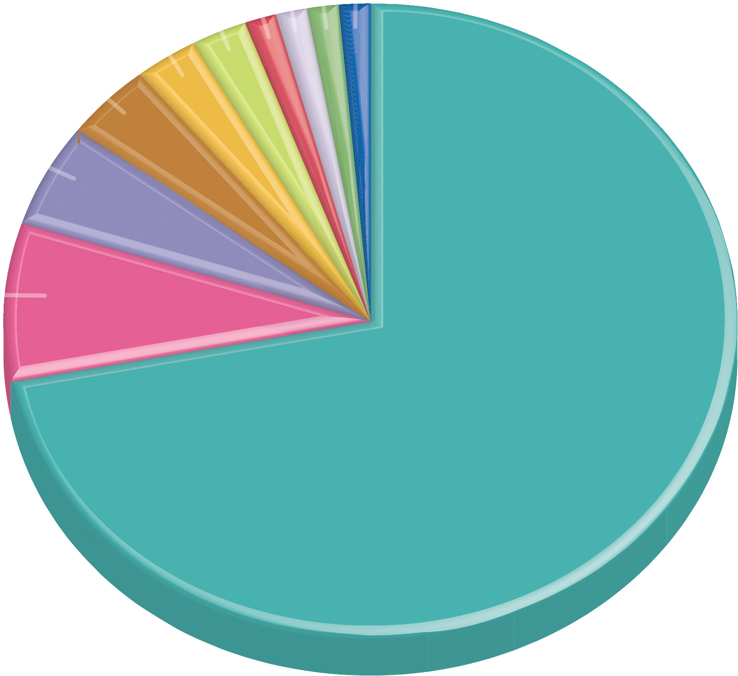
4.3.4 Spatial Dimensions to Cyberattacks (4 of 7)
Figure 4-45: Americans are the most common victim of cyberattacks.
Vietnam
1%
Belarus
1%
Kazakhstan
1%
Ukraine
2%
Philippines
1%
Colombia
2%
Russia
3%
Japan
4%
South
Korea
United States
6%
54%

Slide 55
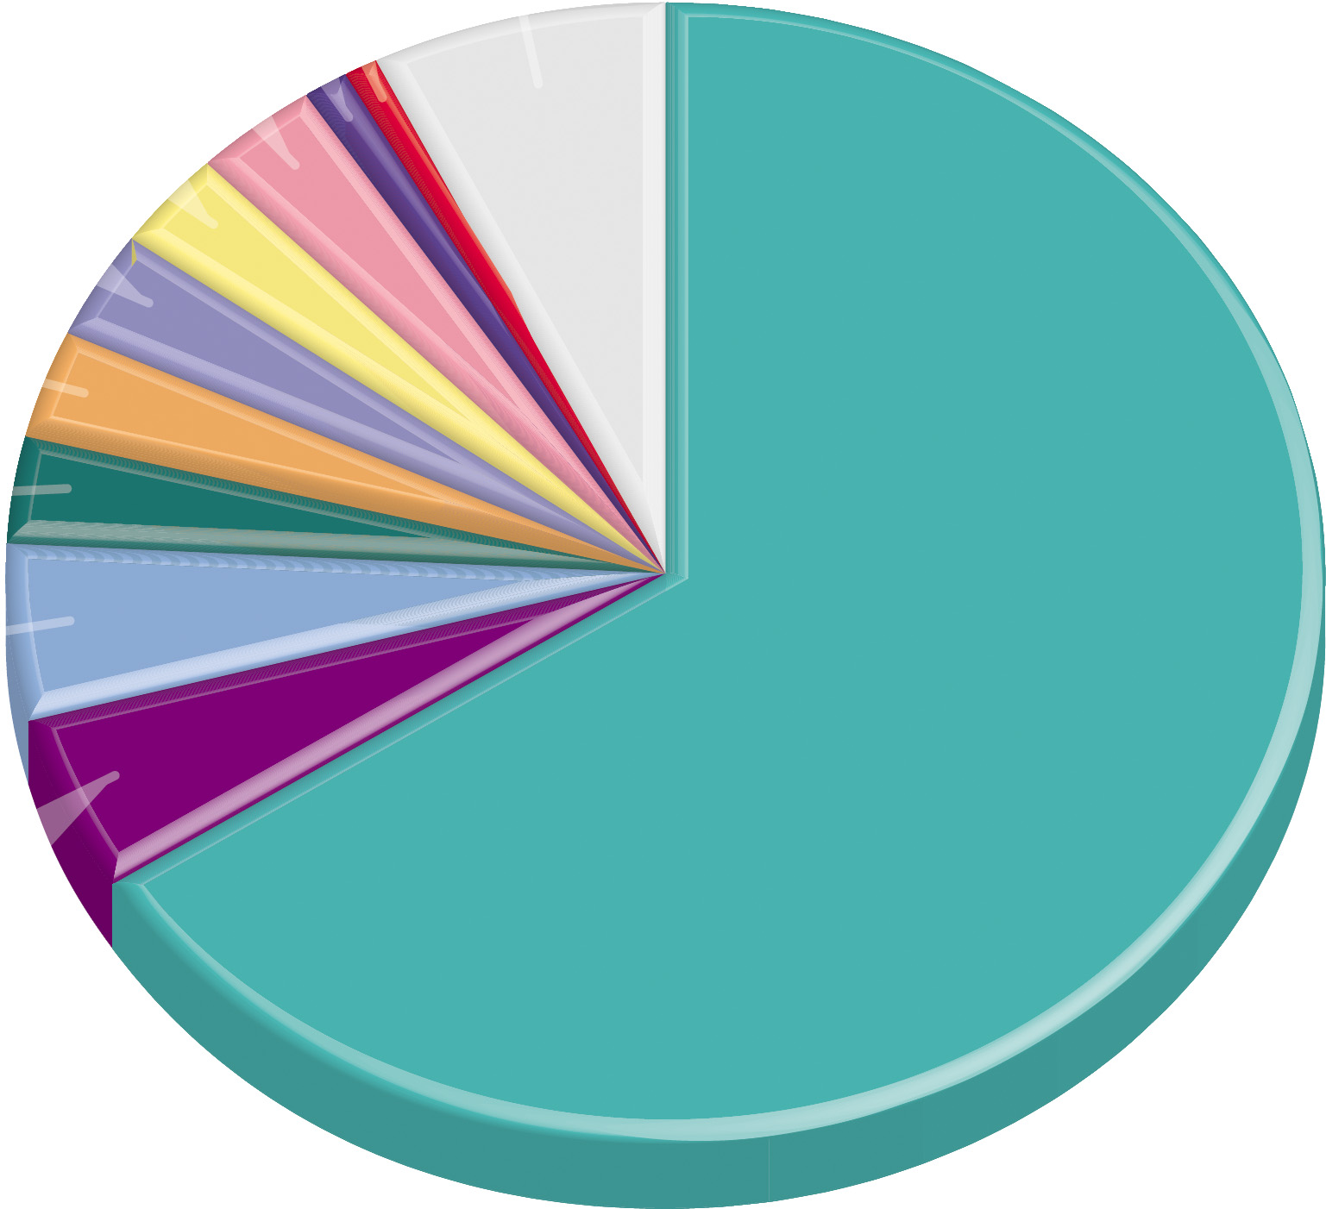
4.3.4 Spatial Dimensions to Cyberattacks (5 of 7)
Figure 4-46: Americans are the most common victim of cyberattacks.
France
1%
Malaysia
3%
China
1%
India
3%
Other
7%
Japan
3%
Australia
3%
United
Kingdom
3%
United States
Germany
66%
5%
Brazil
5%

Slide 56
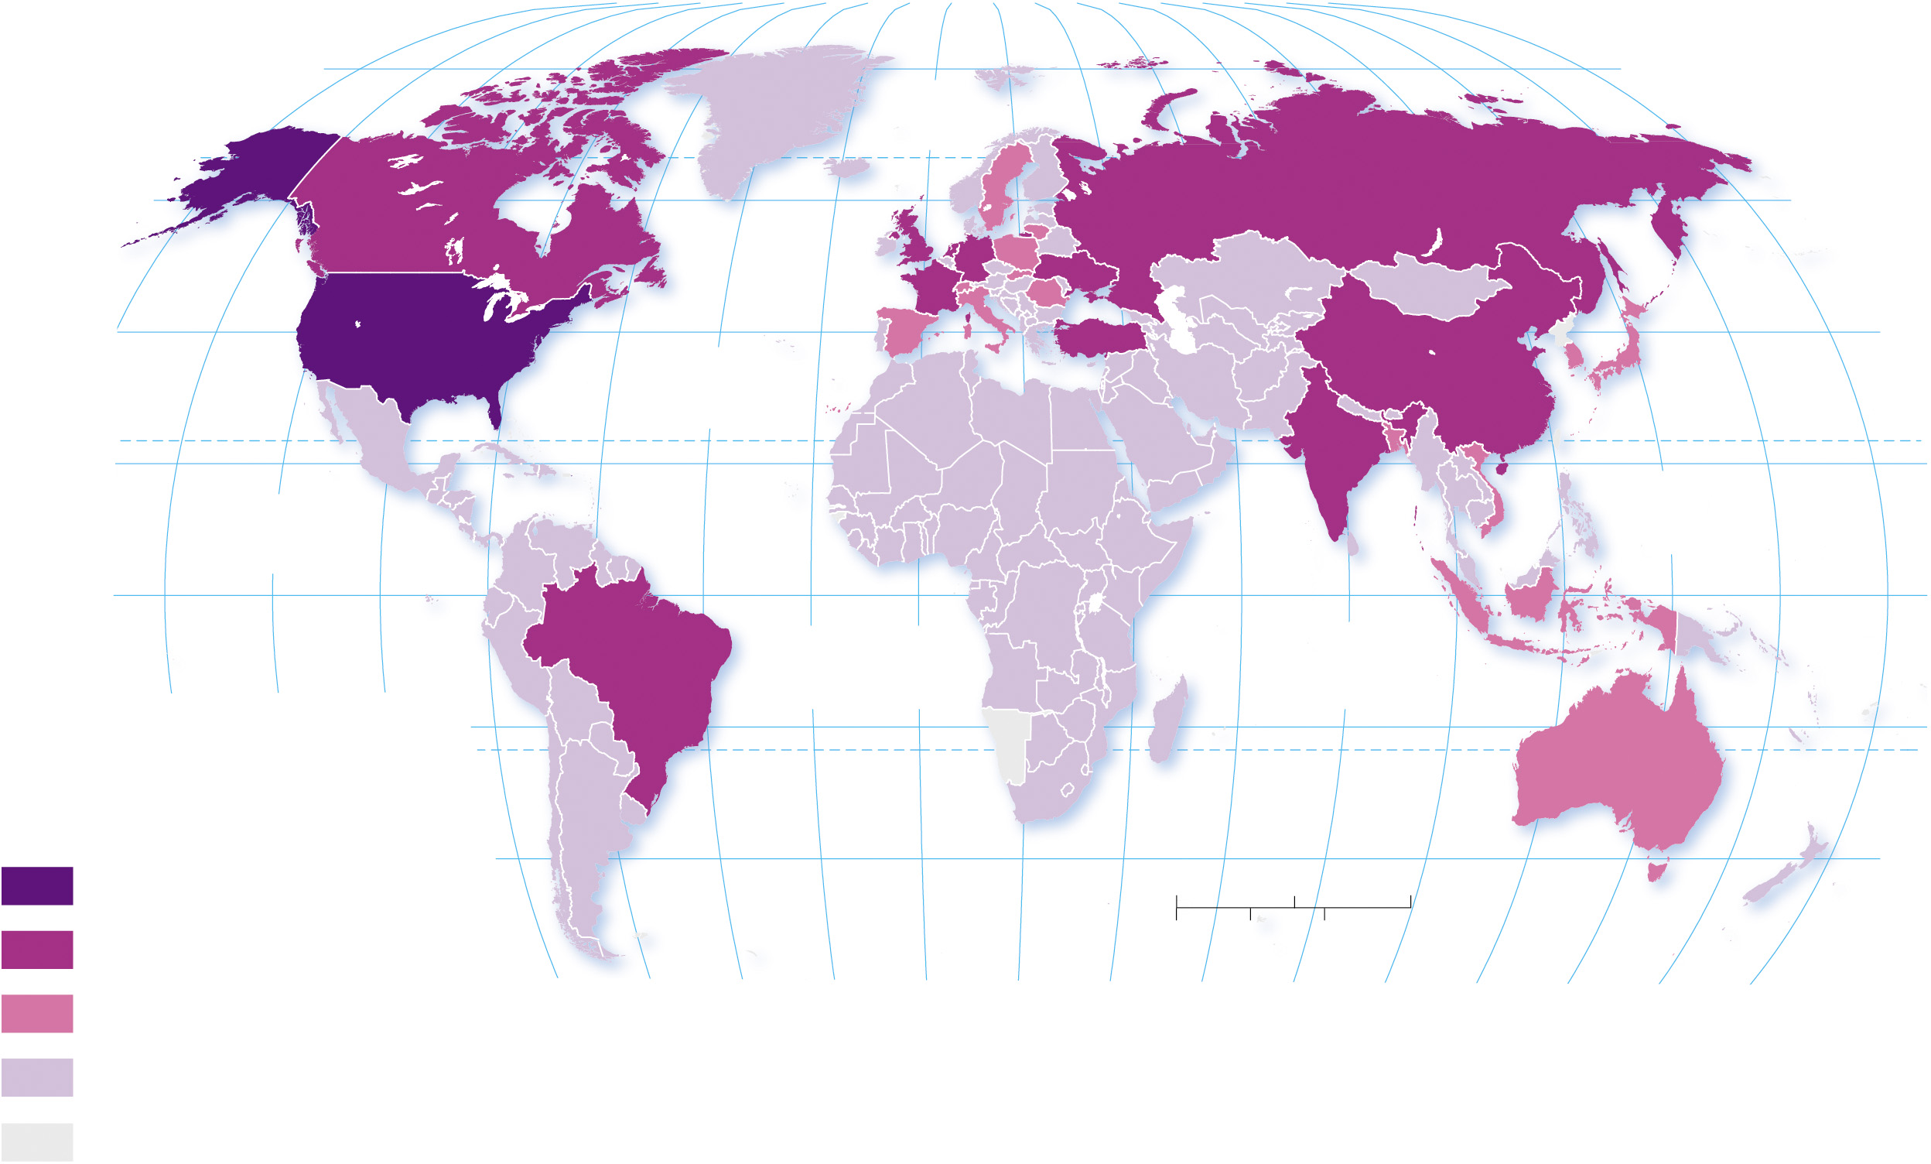
4.3.4 Spatial Dimensions to Cyberattacks (6 of 7)
Figure 4-47: The United States is most often the country of origin of cyberattacks.
80°
160°
140°
120°
100°
80°
60°
40°
20°
0°
20°
40°
60°
80°
100°
120°
140°
160°
180°
80°
ARCTIC
OCEAN
60°
60°
40°
ATLANTIC
OCEAN
40°
20°
TROPIC OF CANCER
20°
PACIFIC
OCEAN
PACIFIC
OCEAN
0°
EQUATOR
0°
140°
120°
100°
ATLANTIC
OCEAN
INDIAN
OCEAN
20°
20°
Origin of attacks
TROPIC OF CAPRICORN
25 million and above
40°
0
1,500
3,000 Miles
40°
10–24.9 million
40°
0
1,500
3,000 Kilometers
1–9.9 million
80°
60°
40°
20°
0°
20°
60°
80°
100°
120°
140°
160°
180°
below 1 million
no data

Slide 57
4.3.4 Spatial Dimensions to Cyberattacks (7 of 7)
Another risk posed by social media is the spread of fake news—a false, often sensational, report disseminated under the guise of an authentic news report
The spread of alternative facts (statements which can be proved false) creates mistrust and drains time resources to verify and fact-check
Trolling is the practice of posting deliberately inflammatory messages on social media in order to provoke quarrels or to agitate people

Slide 58
Key Issue 4: Why Do Cultures Face Sustainability Challenges?
4.4.1 Maintaining Unique Folk Culture
4.4.2 Cultural Convergence
4.4.3 Cultural Divergence

Slide 59
4.4.1 Maintaining Unique Folk Culture (1 of 5)
Many folk cultures are threatened by popular culture
The Amish are an example of a people attempting to maintain their folk culture within the culturally heterogenous United States
The practice of the wedding dowry in India has come under scrutiny, yet persists into modern times

Slide 60
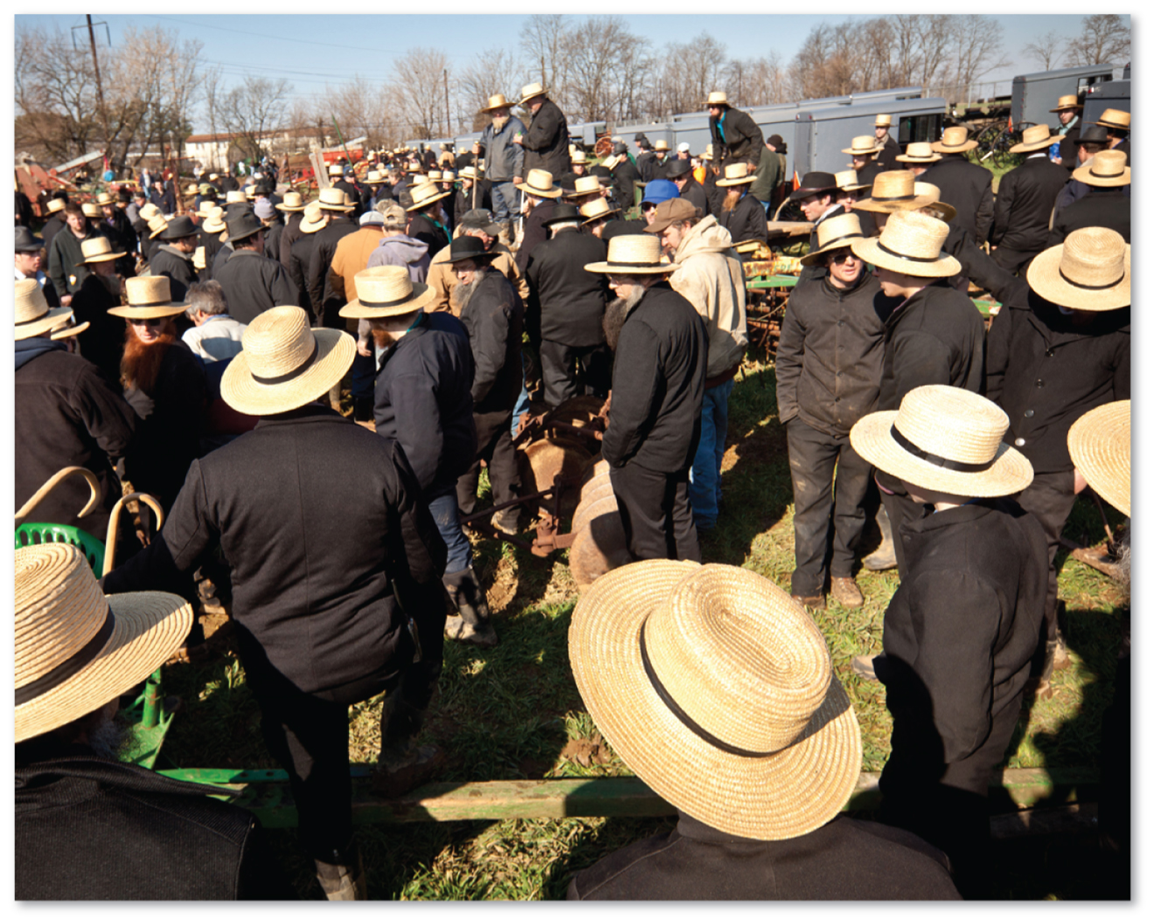
4.4.1 Maintaining Unique Folk Culture (2 of 5)
Figure 4-49: The Amish maintain a distinctive folk culture despite being surrounded by elements of popular culture.

Slide 61
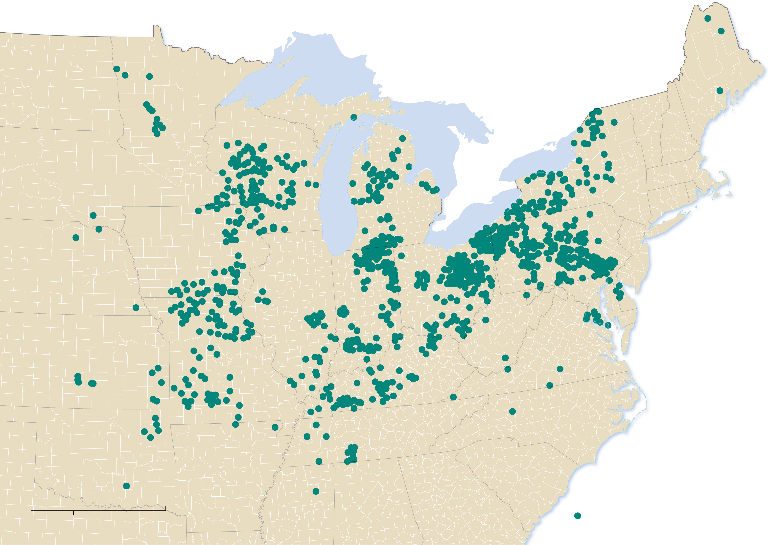
4.4.1 Maintaining Unique Folk Culture (3 of 5)
Figure 4-50: Influenced by the price of land, Amish settlements have diffused from the culture’s hearth in Pennsylvania.
ND
ME
MN
WI
VT
NH
SD
NY
MA
MI
CT
RI
PA
NE
IA
NJ
Lancaster
County
IL
IN
OH
MD
DE
KS
WV
VA
MO
KY
TN
NC
OK
AR
SC
0
150
300 Miles
MS
AL
GA
Amish Congregations,
2017
0
150
300 Kilometers

Slide 62
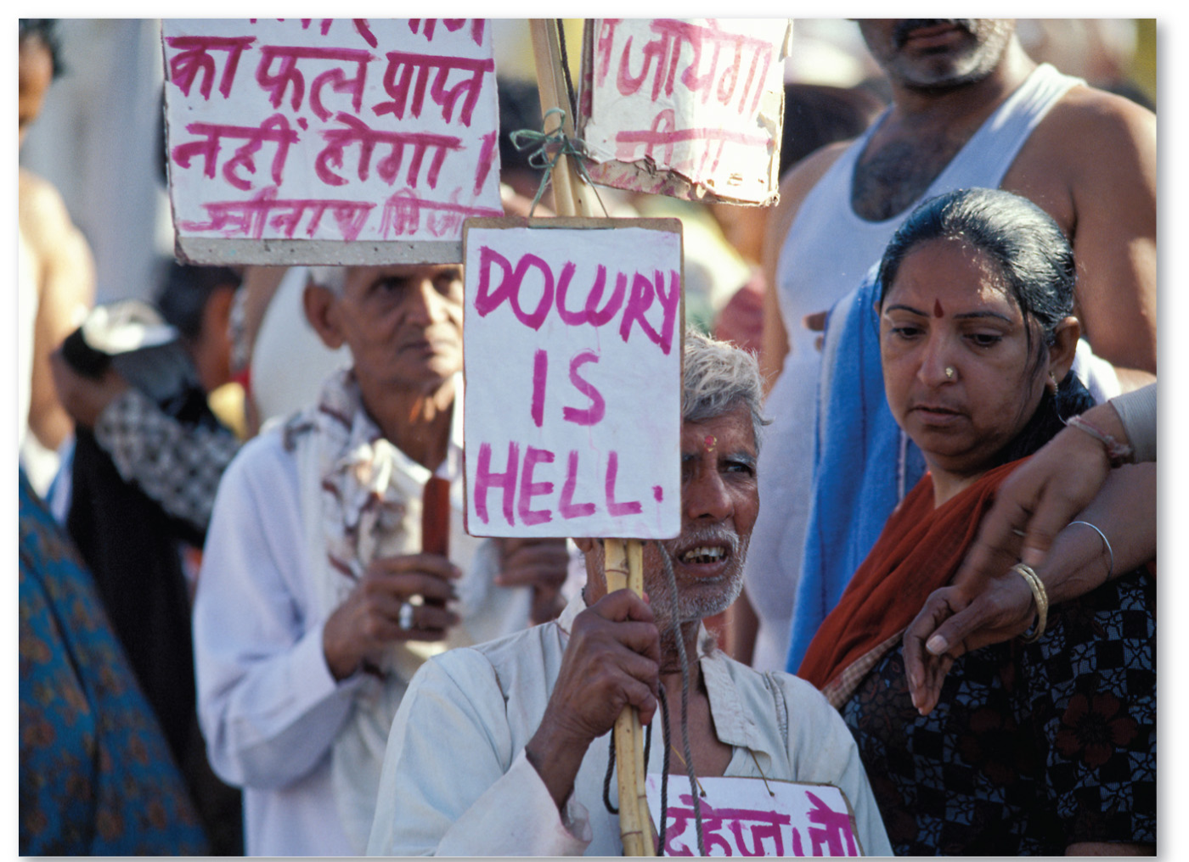
4.4.1 Maintaining Unique Folk Culture (4 of 5)
Figure 4-51: Indians protesting against the marital cultural practice of the dowry, which requires the family of the bride to provide the family of the groom with expensive gifts.

Slide 63
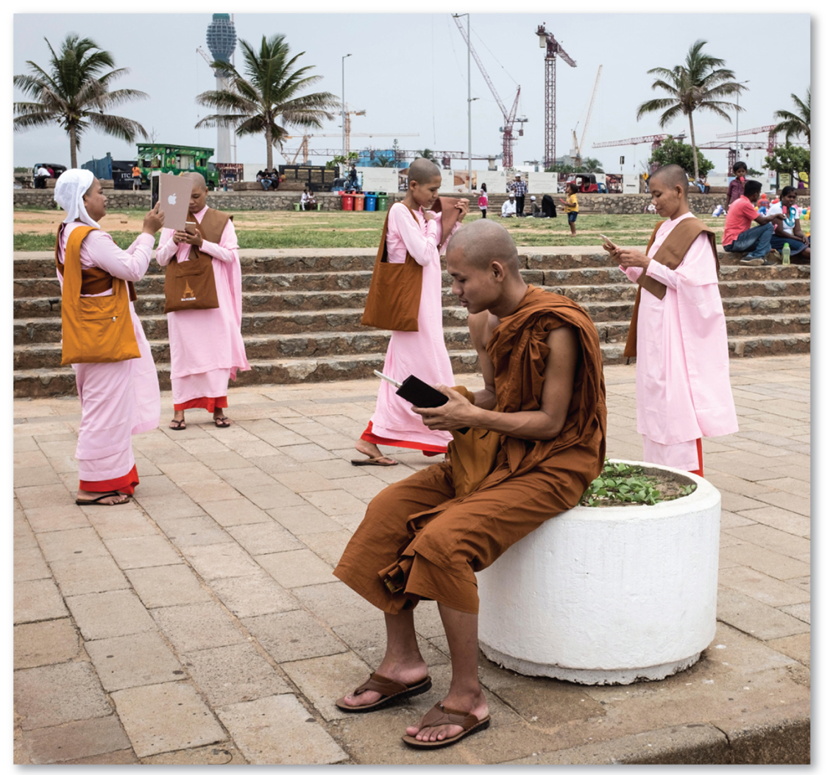
4.4.1 Maintaining Unique Folk Culture (5 of 5)
Figure 4-52: Buddhist monks and nuns from Myanmar wear traditional clothing and check their smartphones while visiting Sri Lanka.

Slide 64
4.4.2 Cultural Convergence (1 of 3)
Popular culture has many positive attributes but poses a risk to folk culture. The spread of popular culture results in a loss of localized folk culture diversity. This process is known as cultural homogenization. Other risks are:
Pollution of the landscape
Depletion of scarce natural resources
Crowding-out of locally owned businesses by global franchises

Slide 65
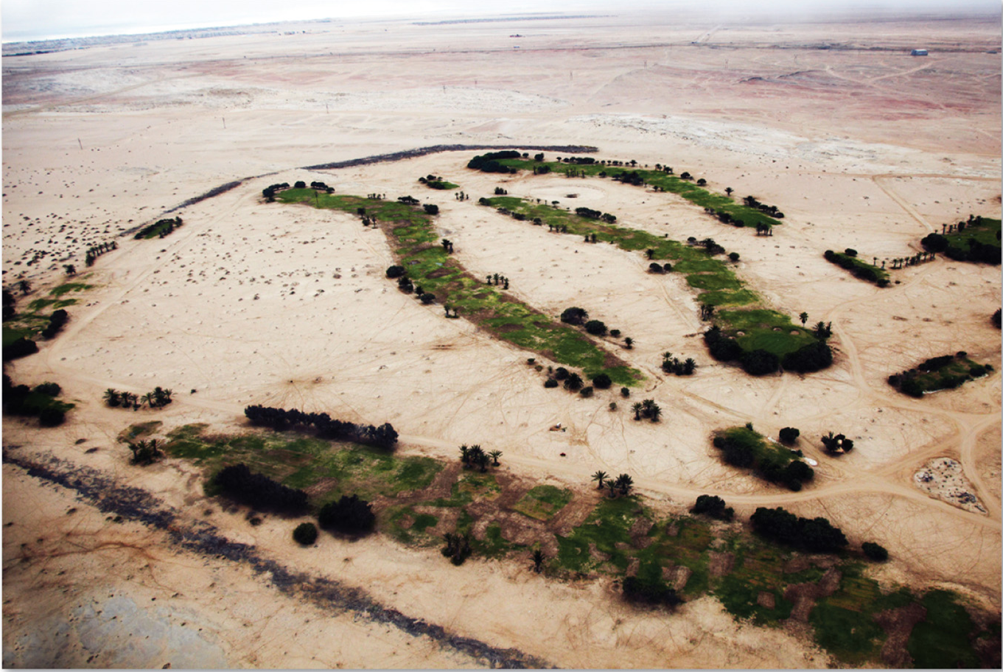
4.4.2 Cultural Convergence (2 of 3)
Figure 4-54: Golf courses are a vivid example of popular culture and require enormous amounts of water, such as the golf course featured here in the Namib Desert.

Slide 66
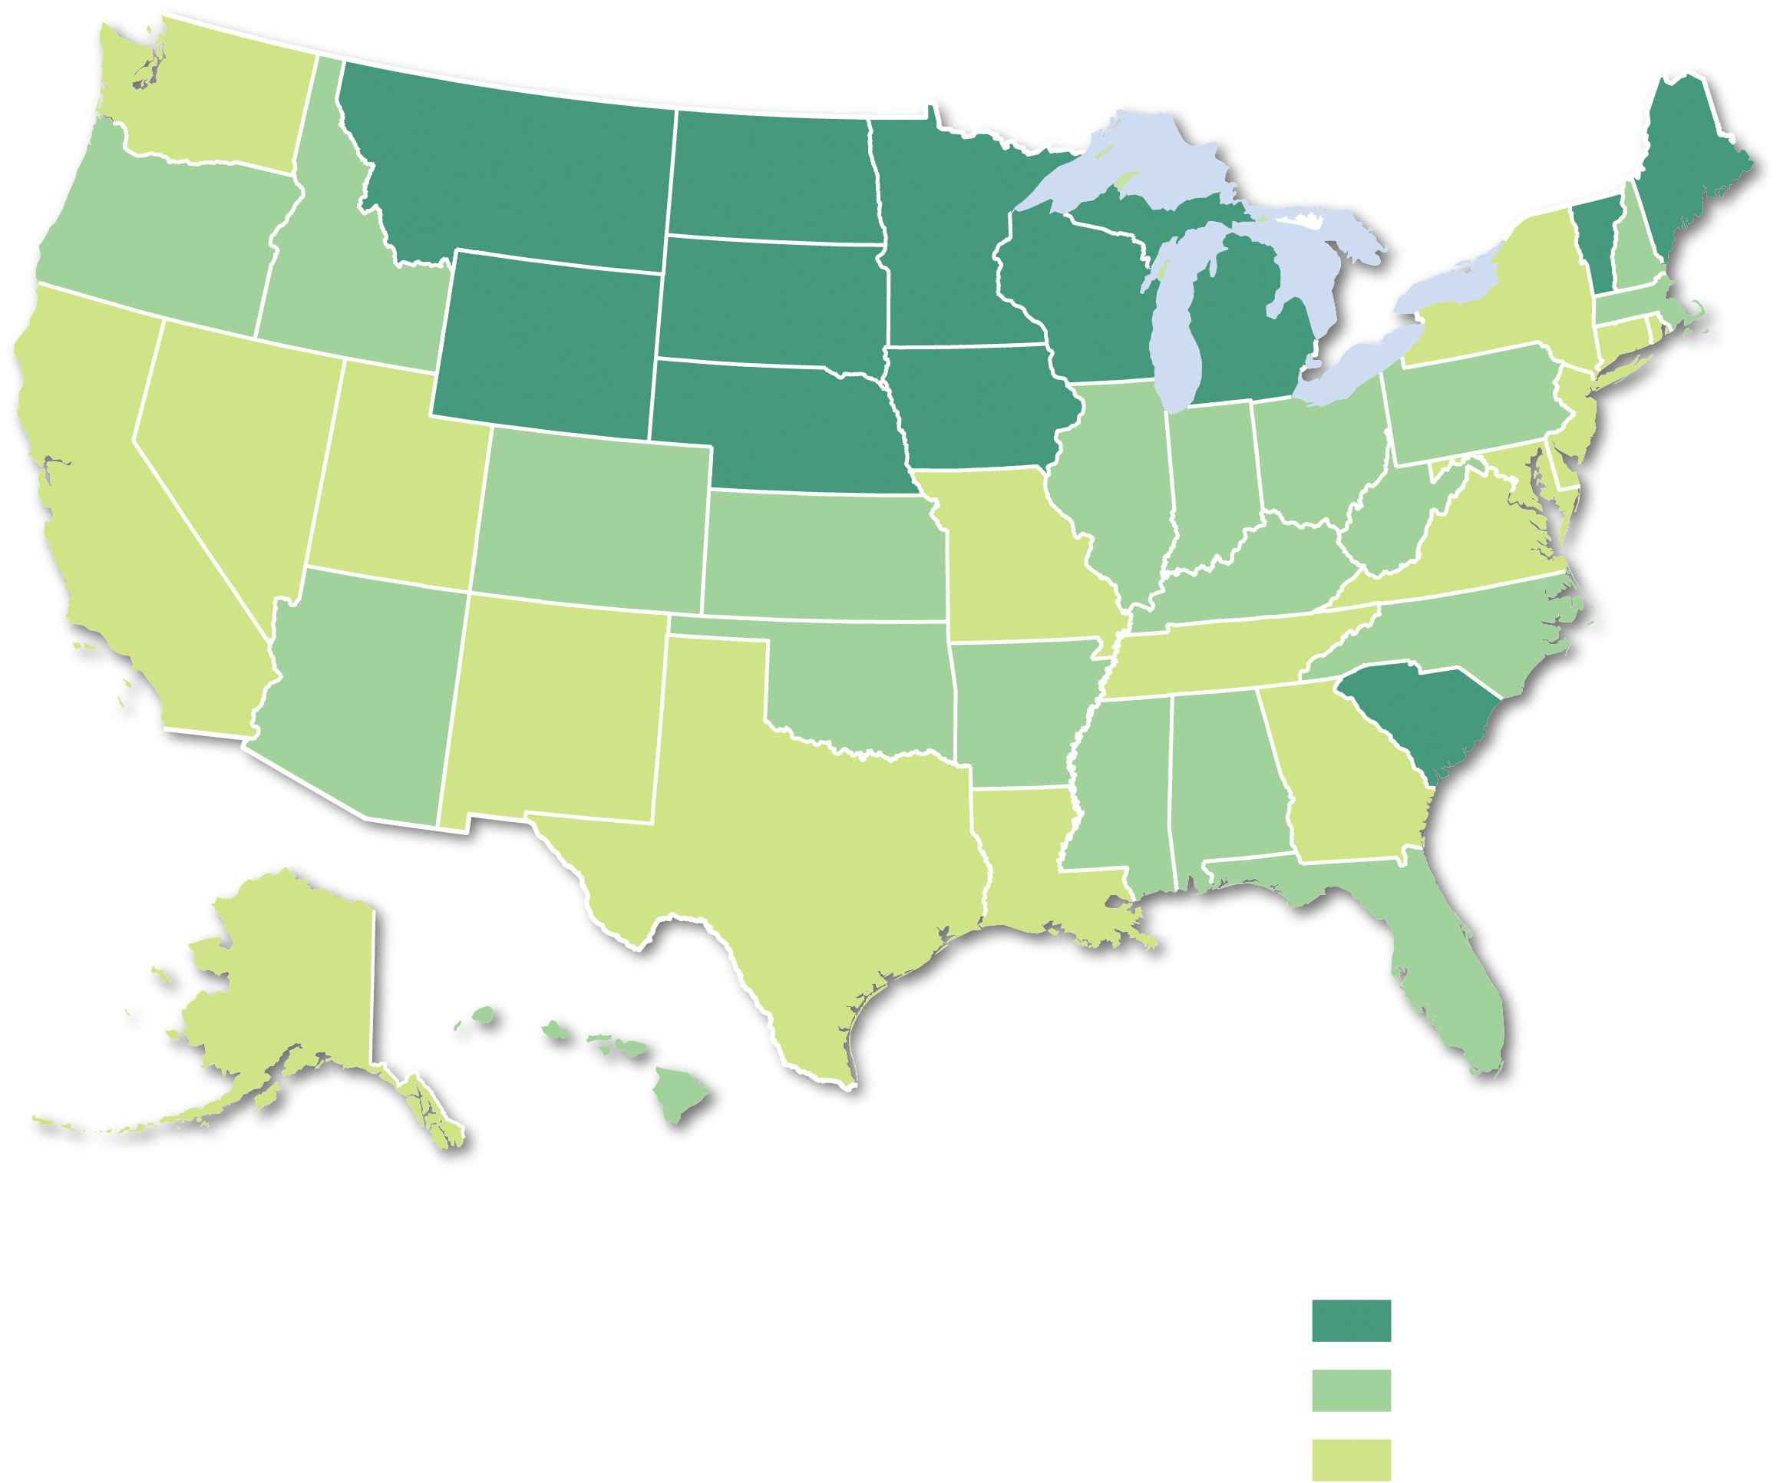
4.4.2 Cultural Convergence (3 of 3)
Figure 4-55: Distribution of golf courses in the United States. Despite the harsher and colder climates, there is a concentration of gold courses in northern states.
Golf courses per
100,000 people
10.0 and above
6.0–9.9
below 6.0

Slide 67
4.4.3 Cultural Divergence (1 of 3)
Popular culture may diffuse rapidly but differences persist in cultural preferences at several scales. Examples can be found of differences between urban and rural residents
Rural areas whose economies focus on agriculture and manufacturing tend to value more traditional forms of popular culture
Urban spaces with concentrations of wealth and diverse ethnic groups may value more progressive forms of popular culture

Slide 68
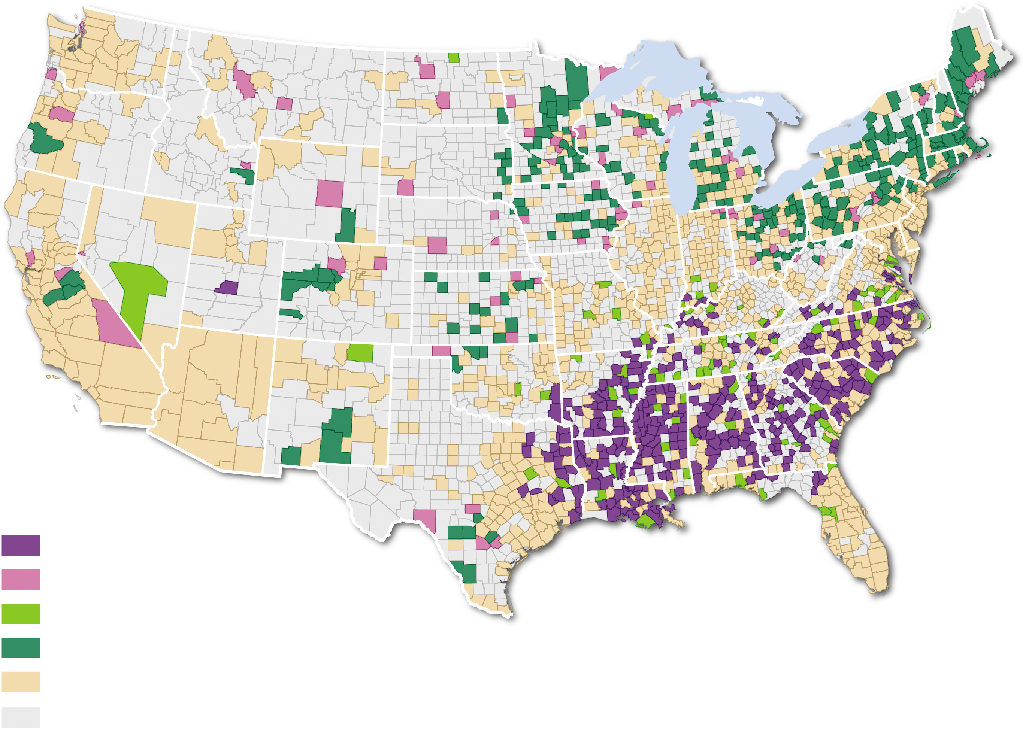
4.4.3 Cultural Divergence (2 of 3)
Figure 4-56: Tweets about beer are more common in northern states, while tweets about church are more common in southern states.
Much more church
More church
More beer
Much more beer
Beer and church equal
No data

Slide 69
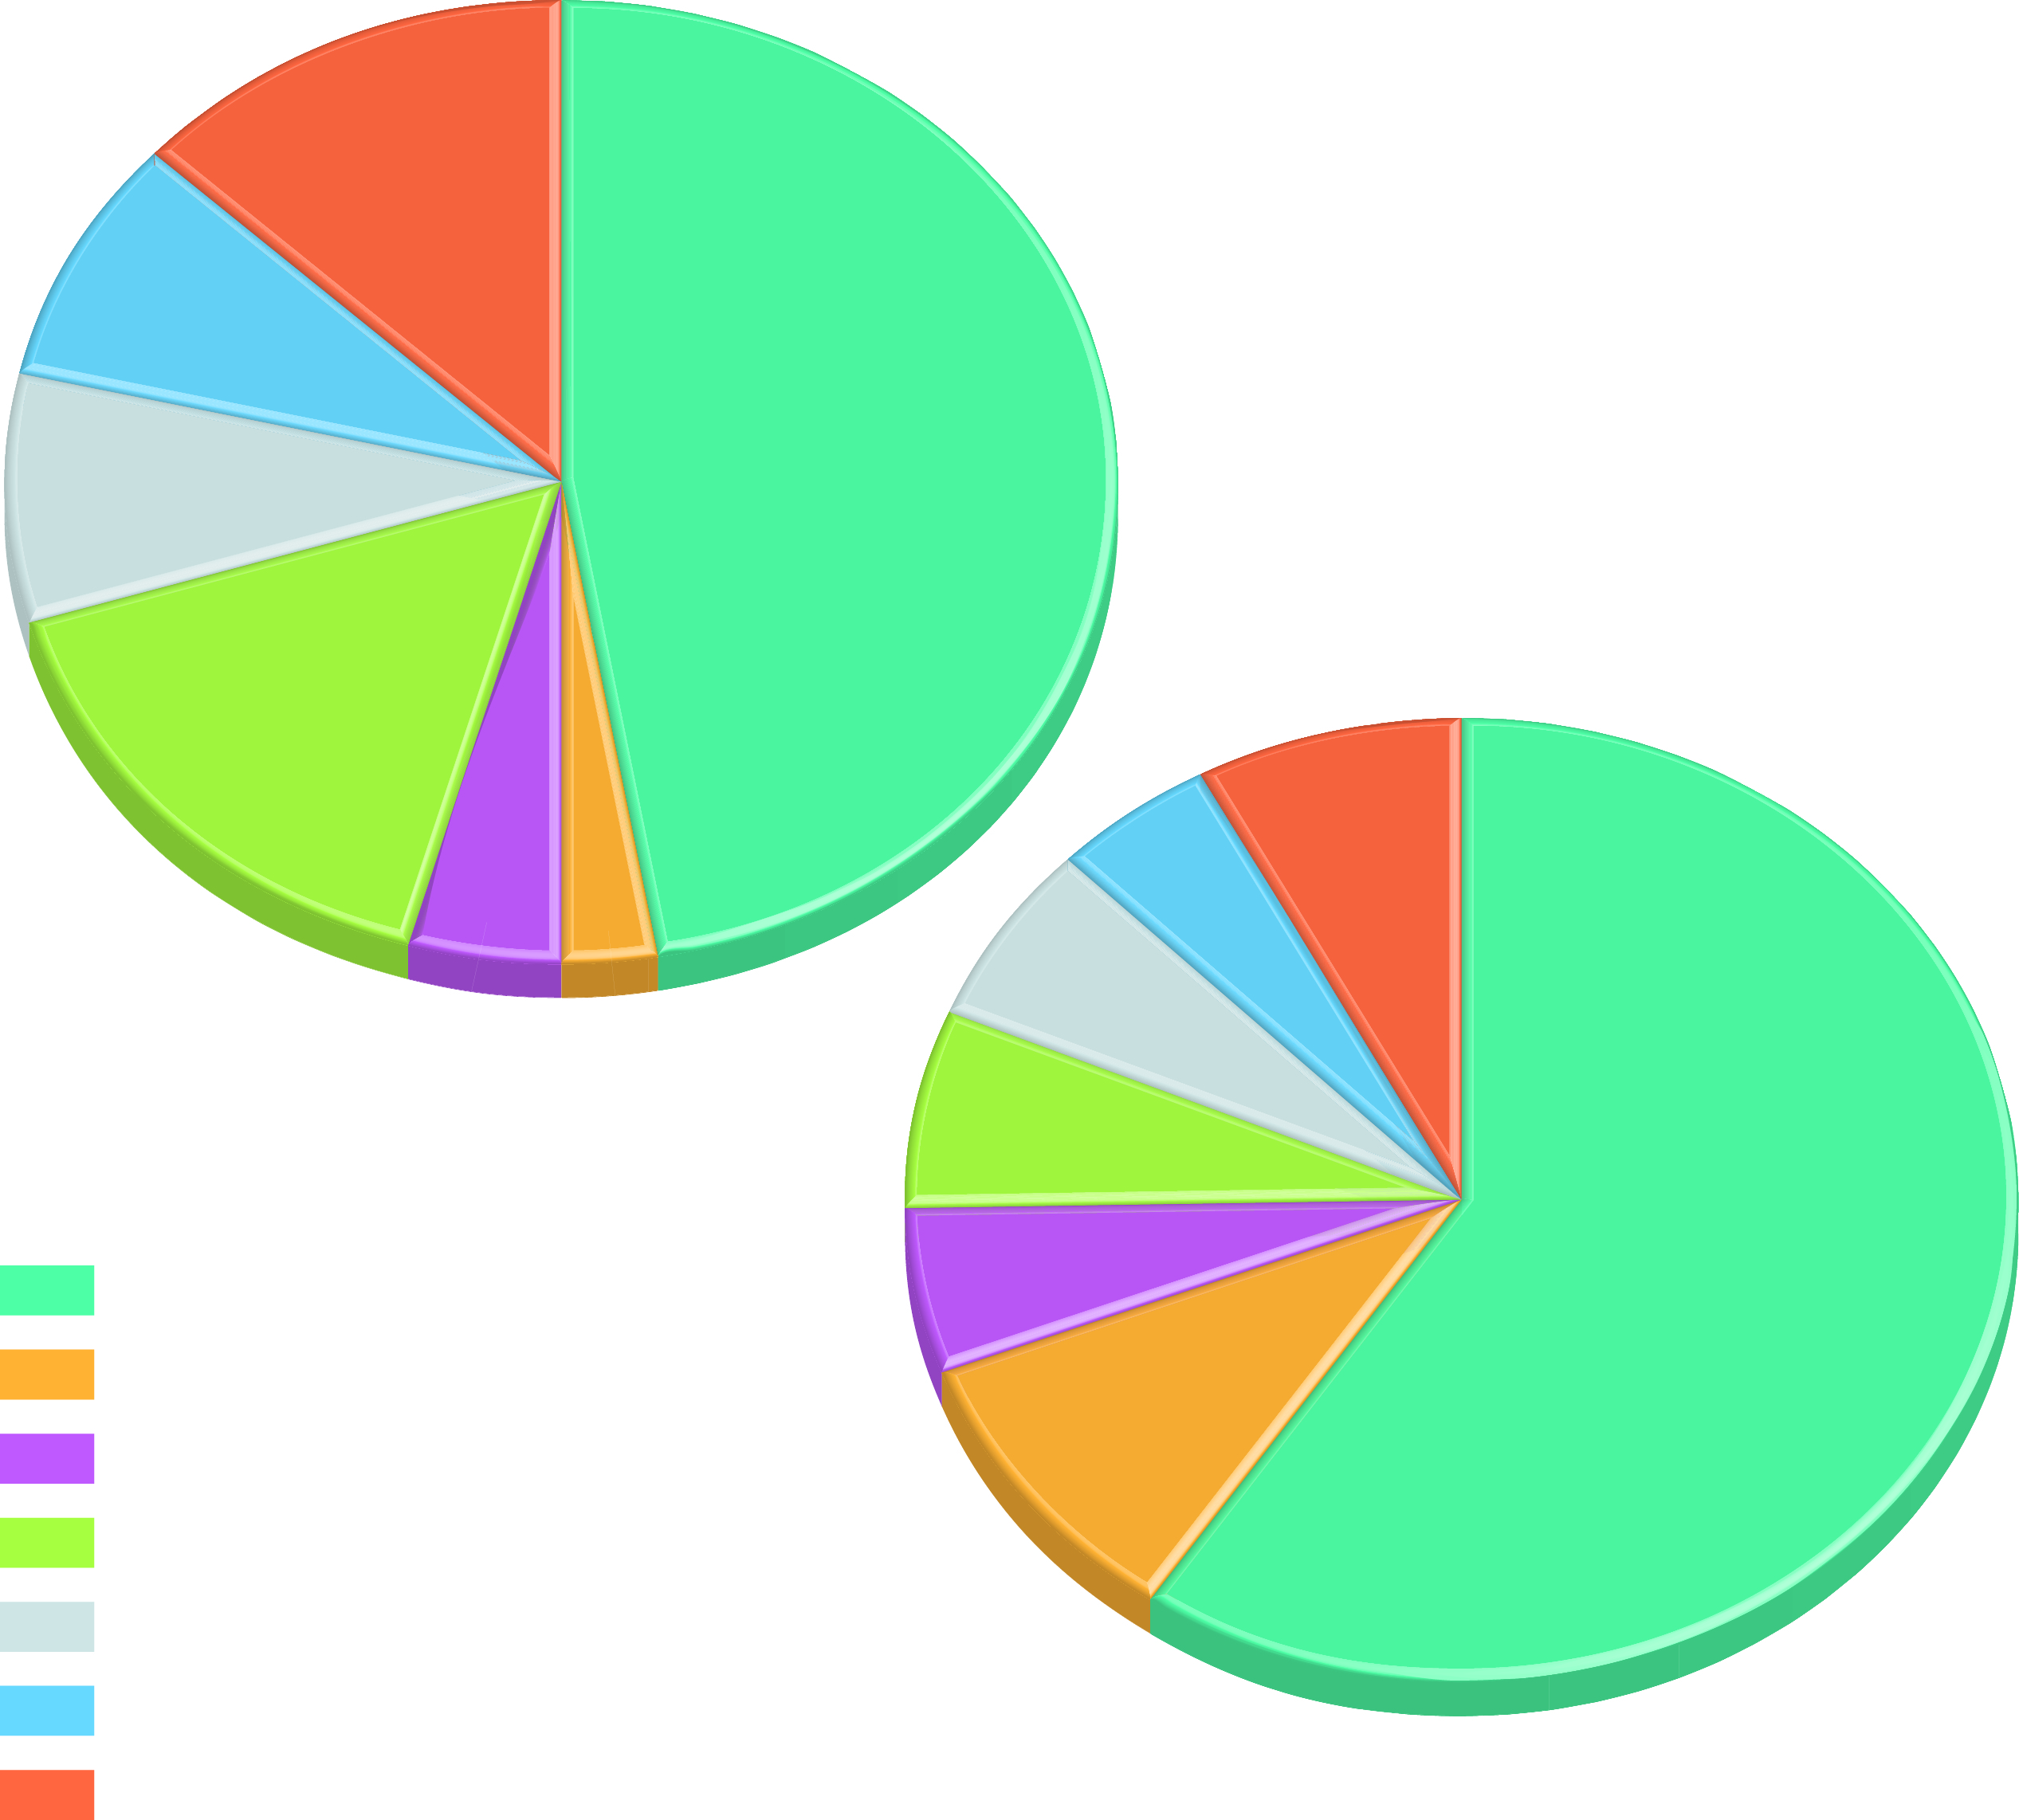
4.4.3 Cultural Divergence (3 of 3)
Figure 4-58: Age also plays a key role in popular culture leisure choices.
0.54
(a) age 20–24
0.35
0.34
1.98
(b) age 65–74
0.66
0.31
0.50
0.41
0.19
0.11
0.44
Weekday leisure hours
3.94
Watching TV
0.37
Reading
0.63
Relaxing/thinking
Computer use for games and leisure
Other activities
Sports and exercise
Socializing and communicating

Slide 70
Copyright
This work is protected by United States copyright laws and is provided solely for the use of instructors in teaching their courses and assessing student learning. Dissemination or sale of any part of this work (including on the World Wide Web) will destroy the integrity of the work and is not permitted. The work and materials from it should never be made available to students except by instructors using the accompanying text in their classes. All recipients of this work are expected to abide by these restrictions and to honor the intended pedagogical purposes and the needs of other instructors who rely on these materials.

